Slide 1
UCSF Perspective: Improving pain management education and care while reducing the opioid burden
Mark Schumacher Ph.D., M.D.
Professor and Chief, Division Pain Medicine
Project Director NIH CoEPE
Dept. of Anesthesia & Perioperative Care
University of California, San Francisco

Slide 2

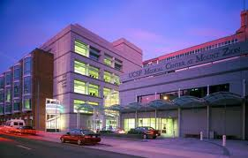
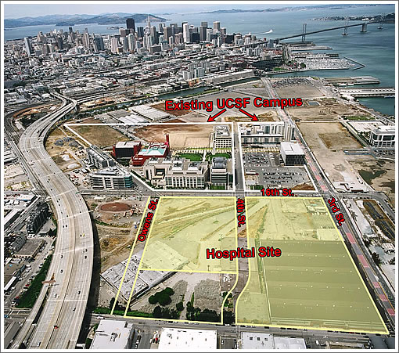
UCSF: Diverse Educational and Care Sites
+ SFGH, SFVA

Slide 3
UCSF: NIH Center of Excellence in Pain Education (CoEP)
IOM report “Relieving Pain in America” 2011
On average medical schools provide about 9 hours of
formal pain management course work
but ..pain is often the primary complaint
NIH “Pain Consortium” launches CoEPE initiative - 2012
National Institute of Drug Abuse steps in to Continue - 2014

Slide 4
UCSF: NIH Center of Excellence in Pain Education (CoEP)
Recognition that appropriate pain management training
as fallen between the cracks as the number of persons
living with chronic pain continue to grow
Medical and other professional schools are often failing to
provide up-to-date, evidence - based training to care for
our citizens suffering from acute and chronic pain
Adults and Children

Slide 5
UCSF: NIH Center of Excellence in Pain Education (CoEP)
UCSF: Selected as one of 13 CoEPE sites in 2012
Only such site in California
Goal: Develop innovative approaches to pain
education and care.
Serve as leaders for Region – Nation

Slide 6
UCSF CoEPE GOALS:
  Assessment of all pain - related curriculum for:
  Medicine, Pharmacy, Nursing, Dentistry
  Replace pain ‘lectures’ with active case learning
  Teach pain management competencies for common
    clinical scenarios
  Develop longitudinal structure spanning all 4 years
  Use simulation to teach Interprofessional Care
  Develop ways to disseminate pain care information
  for local (pain summit), regional and national audience (web)

Slide 7
What is UCSF doing now?
Multimodal Analgesia:
A focus on non-opioid strategies
-non-invasive
-non pharmacologic
-combination of medications / nerve blocks
-UCSF Patients undergoing joint replacement
-Receive combination of peripheral nerve catheter
infusion (LA) plus combination of non-opioids
- Team care for success
Kehlet et al

Slide 8
Multimodal Analgesia
Using multiple non-opioid medications that together
provide superior analgesia with lower side
effects c/w high–dose opioid alone.
-Acetaminophen 1000mg po x 1 preop.
continue throughout hospital course
  -Celecoxib: 400 mg po x 1 preop.
  continue @ 200mg twice daily
    -Gabapentin 600mg po x1 preop.
    continue @ 300mg three times daily
Kehlet et al

Slide 9
Goals of multimodal analgesia
What we see:
-early mobilization
-shorten length of stay: 3-4 day > 1-2 d
-improved satisfaction
-reduced opioid consumption
-reduced nausea / vomiting
-modest cost – low risk

Slide 10
Next Steps:
Extend multimodal approach to other clinical areas
Integrate evidence - based advances in pain care with Pain Education Center (CoEPE)

