Slide 1
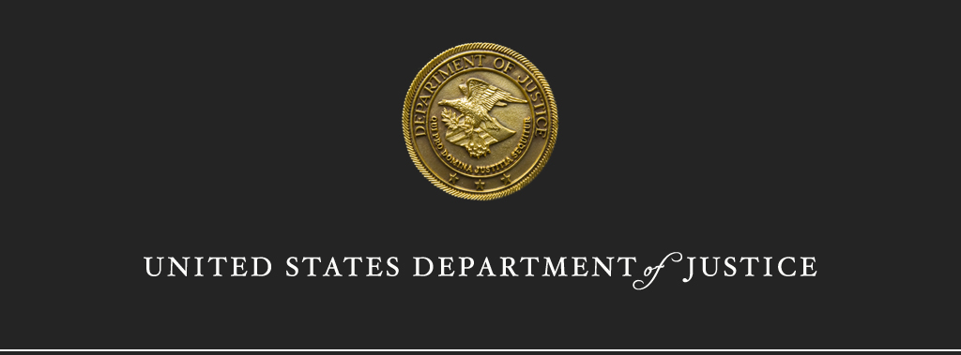
Freedom of Information Act (FOIA)
and Privacy Act Interface

Slide 2
Purpose of the Privacy Act
Protect the privacy of the individuals about whom the government maintains records by:
Limiting the collection, maintenance, use, and disclosure of personally identifiable information.
Allowing individuals to request access to, amendment of, and an accounting of disclosures concerning records about themselves.
General Presumption is Protection

Slide 3
Purpose of the FOIA
Facilitates government transparency and accountability.
Provides a means for the public to “know what the government is up to.”
Permits agencies to protect certain records that fall within any of the nine FOIA exemptions.
General Presumption is Disclosure

Slide 4
Records Covered
Privacy Act | FOIA
Records must be: About an individual, Stored in a system of records, and Accessed by personal identifier. | All agency records.
Privacy Act Record = Agency Record
Agency Record ≠ Privacy Act Record

Slide 5
Records Covered
Agency Records
Agency Records
Privacy Act Records

Slide 6
Privacy Act Definitions
Individual
Record
System of Records
System of Records Notice

Slide 7
Privacy Act Definitions
Individual:
A citizen of the United States or a lawfully admitted permanent resident.
5 U.S.C. § 552a(a)(2)
Does not include:
Organizations
Deceased individuals

Slide 8
Privacy Act Definitions
Record:
“any item, collection, or grouping of information about an individual that is maintained by an agency…”
5 U.S.C. § 552a(a)(4)
Generally, “must both be ‘about’ an individual and include his name or other identifying particular.”
Tobey v. NLRB, 40 F.3d 469, 471 (D.C. Cir. 1994)

Slide 9
Privacy Act Definitions
System of Records:
“a group of records under the control of any agency from which information is retrieved by [personal identifier]”
5 U.S.C. § 552a(a)(5)
The record must be locatable using a personal identifier and the agency must in fact access the records using a personal identifier.
OMB Guidelines, 40 Fed. Reg. 28,948 (July 9, 1975)

Slide 10
Privacy Act Definitions
System of Records Notice (SORN):
Provides notice to the public about a system of records.
Includes, among other items, the agency’s purposes for collecting and routine uses of the information.
If you have questions about whether disclosing records is appropriate, or whether a Privacy Act exemption applies, consult the SORN.

Slide 11
Q&A
Which of the following are examples of Privacy Act records?
Federal student aid application
Government personnel records
Emails containing PII
FOIA request and appeal files

Slide 12
Privacy Act: General Rule
Generally, agencies cannot disclose Privacy Act records without the prior written consent of the individual.
Records may be disclosed without prior written consent under certain conditions.

Slide 13
Privacy Act Conditions of Disclosure
An agency can disclose Privacy Act records without prior written consent in the following circumstances:
(b)(1) Need to know within agency
(b)(2) If required under the FOIA
(b)(3) Routine use published in SORN
(b)(4) Census Bureau
(b)(5) Statistical research (if de-identified)
(b)(6) National Archives

Slide 14
Privacy Act Conditions of Disclosure
(b)(7) Law enforcement request
(b)(8) Compelling circumstances for the health and safety of an individual
(b)(9) Congress
(b)(10) Government Accountability Office
(b)(11) Court order
(b)(12) Pursuant to Debt Collection Act

Slide 15
Access under Privacy Act and FOIA
Both the Privacy Act and FOIA provide rights of access to records.
However, there are differences in the extent of access depending on the statute.

Slide 16
Who has a right of access?
Privacy Act | FOIA
U.S. Citizens Lawful Permanent Residents Note: Citizens of a “covered country” may have access rights pursuant to the Judicial Redress Act of 2015. | U.S. Citizens LPRs Non-U.S. Citizens Organizations ANYONE

Slide 17
First Party v. Third Party Requests
1st Party Request
When an individual asks for records about him/herself.
3rd Party Request
When someone seeks records about another individual.

Slide 18
Processing Requests
1st Party Requests
Process first under the Privacy Act, then under the FOIA for the greatest disclosure.
3rd Party Requests
Process only under FOIA

Slide 19
How to Process First Party Requests
Is the record a Privacy Act record?
If no, continue to FOIA analysis.
If yes, continue to next question.
Does a Privacy Act exemption apply?
If no, release.
If yes, continue to FOIA analysis.
Does a FOIA exemption apply?
If no, release.
If yes, withhold.
Information can only be withheld when both Privacy Act and FOIA exemptions apply.

Slide 20
How to Process Third Party Requests
Process third party requests for Privacy Act records under the FOIA only.
Release records if FOIA requires disclosure:
FOIA requires disclosure if no FOIA exemption applies.
Agency generally needs a FOIA request in hand to release Privacy Act records. Bartel v. FAA, 725 F.2d 1403 (D.C. Cir. 1984).

Slide 21
Q&A
A U.S. Citizen seeks records about their criminal investigation. These records are part of a Privacy Act system of records that is exempt from the access provision of the Privacy Act. The response letter may contain which of the following:
FOIA Exemptions
Privacy Act Exemptions
FOIA and Privacy Act Exemptions

Slide 22
Q&A
A U.S. Citizen seeks records about their neighbor’s criminal investigation. The response letter may contain which of the following:
FOIA Exemptions
Privacy Act Exemptions
FOIA and Privacy Act Exemptions

Slide 23
Privacy Act Exemptions
10 Exemptions
One special
Two general (apply to entire record)
Seven specific (require segregation)
The exemptions apply to certain Privacy Act provisions, such as those concerning access and amendment.

Slide 24
One Special Exemption
Section 552a(d)(5) exempts from disclosure:
“Any information compiled in reasonable anticipation of a civil action or proceeding.”
Self-executing exemption.
FOIA Exemption: 5 (attorney work-product)

Slide 25
Two General Exemptions
(j)(1): CIA systems of records.
FOIA Exemption: 3
(j)(2): Systems of records maintained by a principal function criminal law enforcement agency and the records were compiled for criminal law enforcement purposes.
FOIA Exemption: 7

Slide 26
Seven Specific Exemptions
Agency may exempt a system of records if it contains:
(k)(1): Classified information
FOIA Exemption: 1

Slide 27
Seven Specific Exemptions
(k)(2): Generally applies to investigatory material compiled for law enforcement purposes, other than material within the scope of subsection (j)(2).
FOIA Exemption: 7
NOTE: (k)(2) is limited if the record resulted in a denied right, privilege, or benefit that the individual would otherwise be entitled, or for which he or she would otherwise be eligible.

Slide 28
Seven Specific Exemptions
(k)(3): U.S. Secret Service information
(k)(4): required by statute to be maintained and used solely as statistical records.

Slide 29
Seven Specific Exemptions
(k)(5): Source-identifying investigatory material compiled solely for the purpose of determining suitability, eligibility, or qualifications for Federal civilian employment, military service, Federal contracts, or access to classified information.
FOIA Exemption: 7(C), 7(D)

Slide 30
Seven Specific Exemptions
(k)(6): Testing or examination material used solely to determine individual qualifications for appointment or promotion in the Federal service.
(k)(7): Evaluation material used to determine potential for promotion in the armed services, but only to the extent it would reveal the identity of a confidential source who was granted an express promise of confidentiality.

Slide 31
FOIA and Privacy Act Exemptions
FOIA and Privacy Act exemptions are not exact matches.
Be clear about which statute to apply.

Slide 32
Third Party Information Within a Privacy Act Record
There is no PA equivalent to FOIA Exemptions 6 or 7(C).
Third parties may have a legitimate privacy interest in the information, but the Privacy Act may require disclosure.

Slide 33
How have courts addressed this gap?
Some courts hold that certain third party information is not part of the requesters “record.”
FBI agents and phone numbers. (Nolan)
Non-government info where there is some potential for harassment or harm. (DePlanche)
Nolan v. DOJ, 1991 WL 36547, *9 (D. Colo. 1991), aff’d 973 F.2d 843.
DePlanche v. Califano, 549 F. Supp. 685, 693, 696-98 (W.D. Mich. 1982).

Slide 34
Summary
Understand how to identify a Privacy Act record.
Process records using one statute and one set of exemptions at a time.
Seek guidance on the interface between Privacy Act and FOIA when needed.

Slide 35
Resources
Privacy Act
OMB has primary responsibility for Privacy Act guidance
Agency Privacy Officer
Office of Privacy and Civil Liberties (DOJ Components)
FOIA
Agency FOIA Officer
DOJ Office of Information Policy

Slide 36
Questions?

