Slide 1
MDT Cross-Training: Prosecutors and MDTs
August 9, 2018

Slide 2
Technical overview
If you are experiencing any technical issues with the audio for this session, please let us know in the feedback box.
If you have technical difficulties during the webinar, contact Jason Adams, who is providing technical support for this webinar. His email address is jadams@ovcttac.org.
Today’s session will be recorded and made available on the training website.
If you have questions, type them in the feedback box. We will address as many as possible throughout the webinar.

Slide 3
Elder Justice Initiative
The mission is to support and coordinate the Department of Justice’s enforcement and programmatic efforts to combat elder abuse, neglect, and financial fraud and scams that target older adults.
The Initiative does so by—
Promoting justice for older adults.
Helping older victims and their families.
Enhancing state and local efforts through training and resources.
Supporting research to improve elder abuse policy and practice.

Slide 4
Elderjustice.gov
You’re fighting elder abuse on the front lines. We’ve got your back.
The mission of the Elder Justice Initiative is to support and coordinate the Department’s enforcement and programmatic efforts to combat elder abuse, neglect, and financial fraud and scams that target our Nation’s seniors.
Notes:
The elder justice website maintains resources for prosecutors, law enforcement officers, victim service providers, as well as victims and their loved ones.

Slide 5
About the MDT TAC
A new project from the Elder Justice Initiative.
Our mission is to provide tools, resources, and individualized consultations to facilitate the expansion of elder abuse case review multidisciplinary teams across the Nation.
Notes:
Talitha

Slide 6
Services
Responding to requests for materials (e.g., sample documents or research)
Phone and email consultations to discuss problem solving and in-person consultations for communities needing a more hands-on approach
Educational opportunities such as webinars
Newly launched MDT Guide and Toolkit
Notes:
Talitha

Slide 7
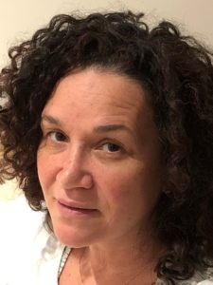
PRESENTER
Lisa Rachmuth, L.M.S.W.
Deputy Director, MDT
New York City Elder Abuse Center
Weill Cornell Medicine
Division of Geriatrics and Palliative Medicine
Notes:
Lisa Rachmuth is the deputy director of the New York City Elder Abuse Center’s (NYCEAC) MDTs. She manages the day-to-day operations of NYCEAC’s existing MDTs and is spearheading the expansion of the MDTs to all five boroughs. Prior to joining NYCEAC, Ms. Rachmuth was the director of clinical initiatives and programming for the New York City Human Resource Administration Office of Domestic Violence. Through these two positions, she has worked with systems, communities, and individuals affected by and dedicated to domestic violence and elder abuse. Ms. Rachmuth holds a master’s degree in Social Work from the University of Pennsylvania. She has 27 years of social service experience, with a particular expertise in child abuse, intergenerational abuse, domestic violence, and housing initiatives for individuals and families. In addition to her years of clinical and administrative experience, she is an experienced workshop curriculum developer and presenter. She is also an adjunct professor at the Silberman School of Social Work and a board member for an organization called Evenfooting.

Slide 8
NYCEAC Announces new paper
The Role of Prosecutors on MDTs

Slide 9
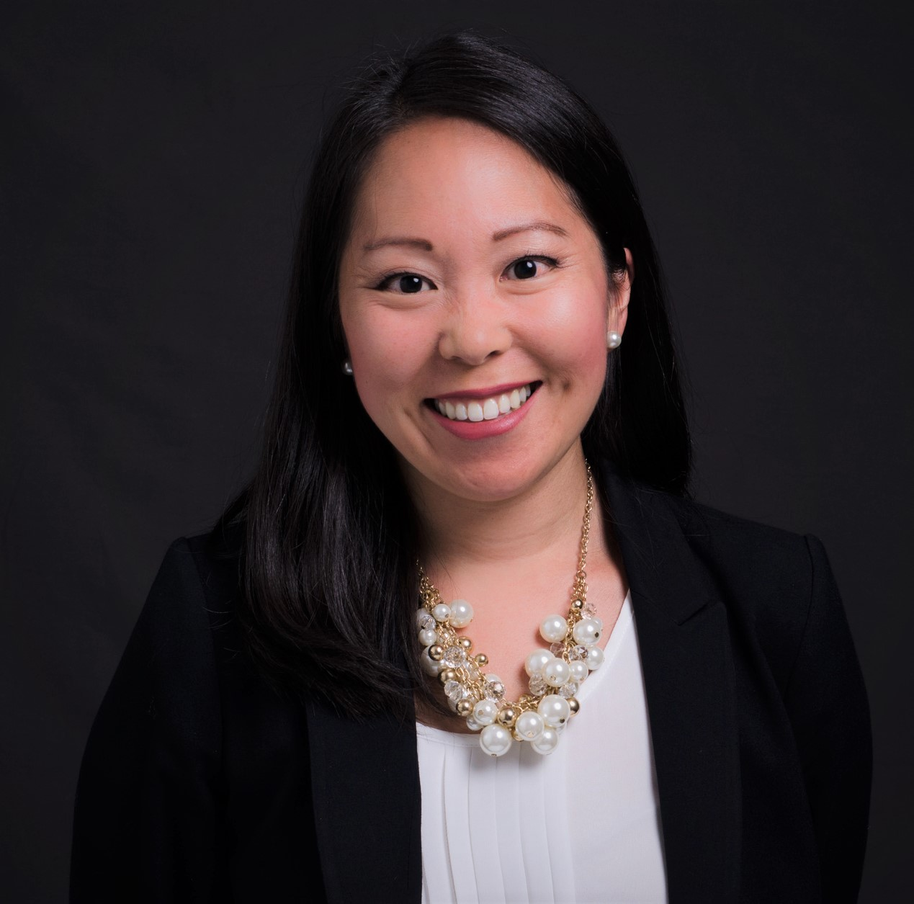
presenter
Nicole Sato
District Attorney
San Mateo County
District Attorney’s Office
California

Slide 10
Understanding the Role of the Prosecutor

Slide 11
Common misconceptions
The prosecutor is the victim’s personal attorney.
The prosecutor is responsible for investigating the entire case.
If the case is not filed, it is because the prosecutor did not believe the victim.
The prosecutor must obtain a certain percentage of convictions.

Slide 12
How do criminal cases begin?
Fiduciary
DA’s Office
APS
Ombudsman
Police Department
Public Guardian
Concerned Citizen/ Mandated Reporter

Slide 13
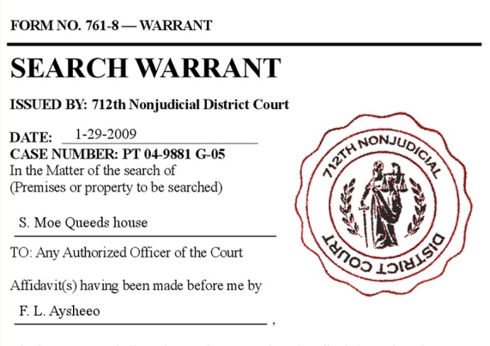
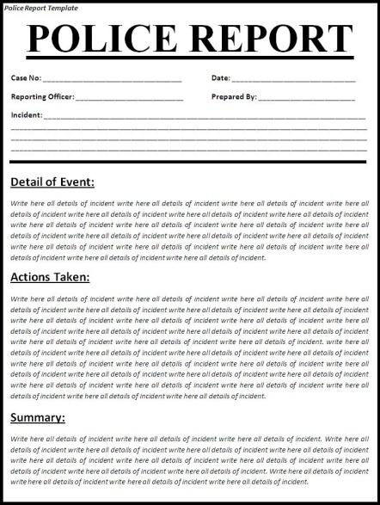
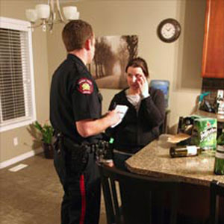
What does the investigation look like?

Slide 14
PHYSICAL EVIDENCE
Video surveillance
Audio or video recorded interviews
Photographs
DNA or fingerprints
911 calls
Data contained on computer
Cell phone evidence
Cell tower data, text messages, etc.

Slide 15
DOCUMENTARY EVIDENCE
Bank records
Medical records
Reports by paramedics or firefighters
APS reports
Real estate documents (deeds, loan paperwork)
Deposition transcripts or other documents from civil cases

Slide 16
Police Report – now what?
File now.
Decline to file.
Send back to police
for follow up.

Slide 17
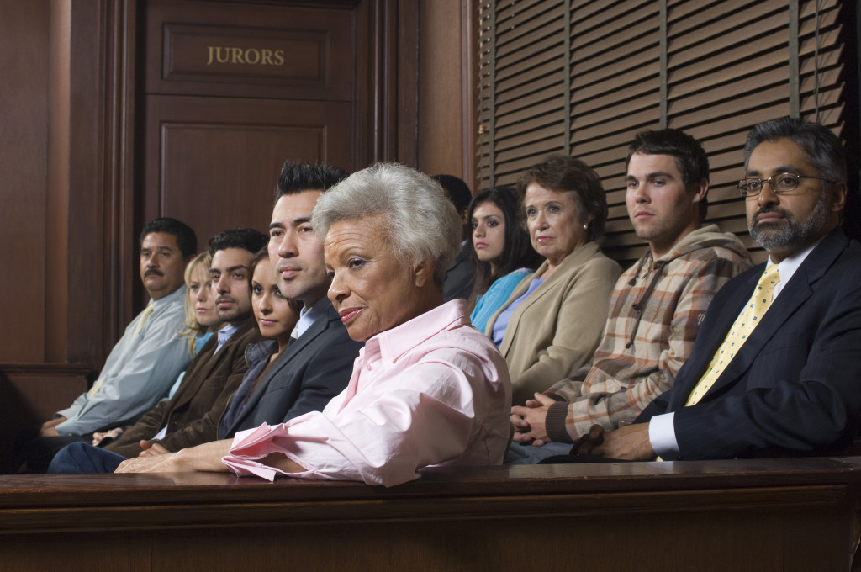
Will the DA’s Office prosecute?
Can I prove the charges beyond a reasonable doubt?
Will a jury convict?

Slide 18
Ethical duty
If there is a reasonable explanation for the evidence that is consistent with lack of guilt, we cannot proceed. We can only file cases that we believe we can prove beyond a reasonable doubt.

Slide 19
Will we file? Illustrative case #1
Suspect Myra is the eldest daughter of the 91-year-old victim. The victim’s other daughter, Patty, went to the police department with her mother to make a police report. The victim reported that Myra transferred the deed to her residence into Myra’s name without her permission. Myra also had power of attorney for her mother.
The victim, who had been living in a care facility, stated that Myra had her sign various documents. According to the victim, Myra told her that if she wanted to return home, she needed to sign the documents. The victim thought the documents she was signing were stating that Myra was going to take care of her.
Patty also provided a statement to the police. Patty discovered that the deed to her mother’s home was now in Myra’s name. She did not believe the victim willingly signed the documents and believed Myra had tricked her.

Slide 20
Will we file? Illustrative case #1
Police interviewed the suspect, Myra. According to Myra, when her father died, Patty moved into her mother’s home. Myra received a call from APS telling her that her mother had been neglected. Patty was evicted from the residence and, as a result, her mother ended up living in a care facility. Myra took her mother to see an attorney, who rewrote her mother’s will and excluded Patty from the will. Myra claimed that her mother knew she was putting the house in Myra’s name. Myra told police that she suspected Patty was manipulating her mother.
There were no issues with the victim’s capacity to make financial decisions.

Slide 21
Will we file? Illustrative case #2
Police responded to a report of a domestic dispute at a residence. A neighbor reported hearing a loud commotion coming from the home. Upon arrival, the officers contacted a 75-year-old woman, who said that her 40-year-old son pushed her against the wall and slapped her in the face two times, causing her to fall to the ground. She was visibly upset and told the officers that she is afraid of him.
Police spoke with the woman’s son, who denied making physical contact with her. He claimed that his mother was upset over a verbal argument they had because she did not approve of his new girlfriend or his spending.
The elderly woman had no injuries. No one else saw what happened.

Slide 22
The Prosecutor and the Multidisciplinary Team

Slide 23
Collaboration with other disciplines
Contributions by the Prosecutor | Benefits for the Prosecutor
Can obtain a criminal No Contact Order for the victim. | Can learn of potential cases before they are reported to law enforcement.
Can obtain restitution for the victim as part of the criminal case. | Can gain more insight about a victim or the victim’s family dynamic.
Can help facilitate dialogue with law enforcement. | Other disciplines may have already achieved a victim’s trust.
Can encourage all disciplines to work toward a collective goal. | May obtain evidence or information needed for criminal prosecution faster.

Slide 24
Edapt success story
The victim was 80 years old, autistic, and diagnosed with stage 3 lymphoma cancer. He was admitted to the hospital when a nurse checked in on him at his home and found him weak and lying in his own feces and urine. The victim lived alone with no family or friends.
The defendant worked for a board and care placement agency and was introduced to the victim in order to help place him at a board and care facility. Within 2 days of meeting the victim at the hospital for the first time, the defendant had the victim sign the deed to his home over to a limited liability company (LLC) owned by the defendant. The defendant also had the victim sign a durable power of attorney for control over all of his finances at the victim’s banking institution. The victim thought he was signing paperwork to consolidate his assets. The defendant recorded the deed and power of attorney at the county recorder’s office the next day.

Slide 25
Edapt success story
Although the defendant claimed to have left a $150,000 check with the victim, the victim never received any money for his home. The victim also had a reverse mortgage on his home that was never paid off.
During an interview with police and a representative from Aging and Adult Services, the defendant denied any affiliation with the LLC and denied living at the address associated with the LLC. The defendant was listed as the owner of the LLC with the Secretary of State.
The execution of a search warrant at the associated address revealed that the defendant was living at the address listed for the LLC. Officers seized a computer that showed the defendant was forging and manufacturing documents after his arrest.

Slide 26
Issues along the way
The victim filed a civil lawsuit against the defendant to get his home back.
While the criminal case was still pending, the victim signed a declaration under penalty of perjury attesting to several damaging facts set forth by the defendant.
The notary public testified at a civil deposition that the victim appeared to understand he was signing over the deed to his home.

Slide 27
Edapt success story: the trial
The victim passed away 2 years to the day that he signed the deed to his home.
The jury trial lasted 3 weeks.
Several witnesses testified: investigators, nurses, representatives from Aging and Adult Services, a neuropsychologist, the notary public, and an expert geriatrician.

Slide 28
Edapt success story: outcome
After a little less than 1 day of deliberations, the jury found the defendant guilty of both felony counts:
Theft from an Elder
Filing of a False Document

Slide 29
Some important lessons
Collaboration with different agencies and involved parties is critical to more efficient, effective investigation and prosecution.
Remember: We all want our elderly population to be free from abuse. We are on the same team.
Do not be discouraged from calling or contacting the prosecutor.

Slide 30
Thank you for the work you do to protect and serve our elderly communities.

Slide 31
Q&A

Slide 32
Contact the MDT TAC
For consultation referrals or to collaborate, contact:
Talitha Guinn-Shaver
202–598–0292
talitha.j.guinn-shaver@usdoj.gov

Slide 33
Questions & suggestions
www.elderjustice.gov
can be emailed to
elder.justice@usdoj.gov

