Slide 1
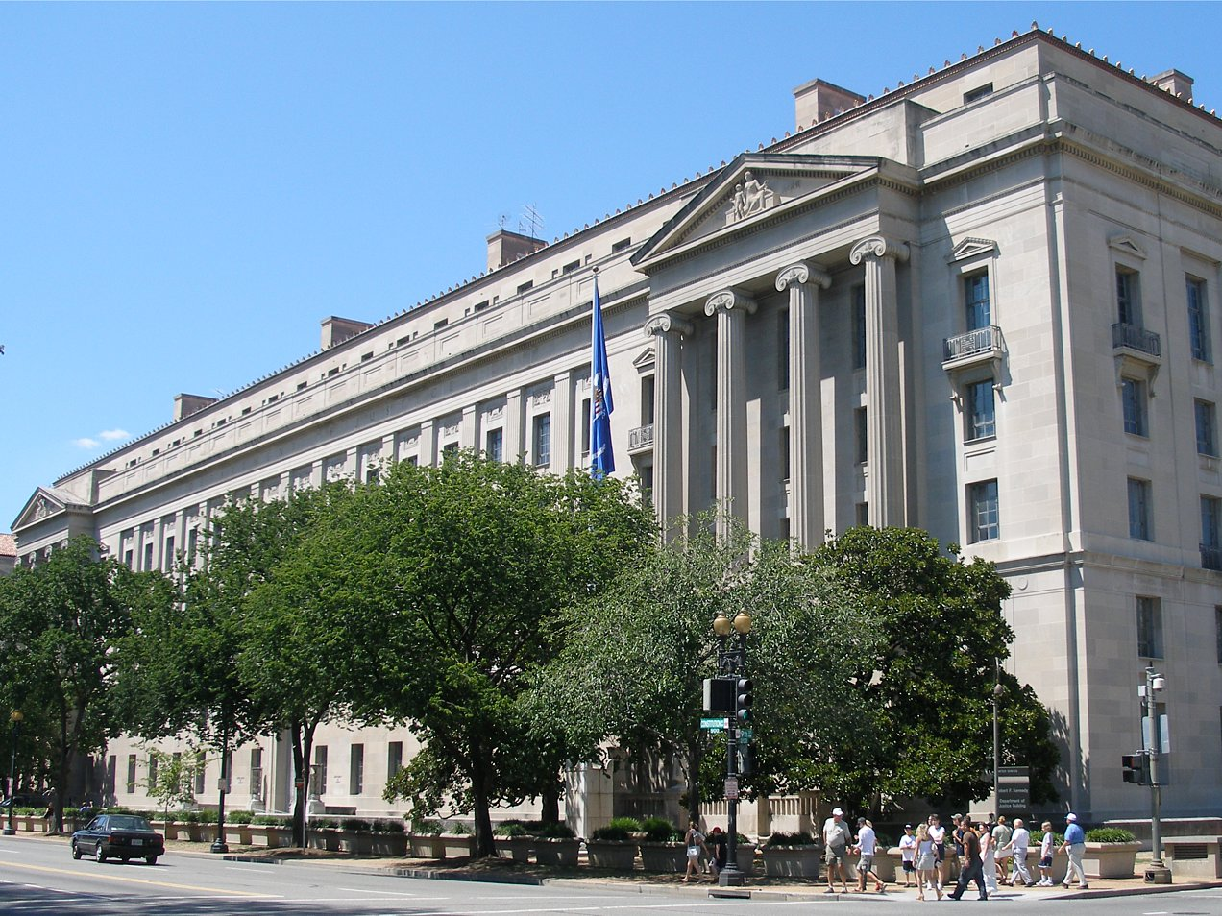




Successful Collaboration Between APS And Victim Services
May 31, 2018

Slide 2
Technical overview
If you are experiencing any technical issues with the audio for this session, please let us know in the feedback box.
If you have technical difficulties during the webinar, contact Kaila Hough, who is providing technical support for this webinar. Her email address is Khough@ovcttac.org.
Today’s session will be recorded and made available on the training website.
If you have questions, type them in the feedback box. We will address as many as possible throughout the webinar.

Slide 3
Elder Justice Initiative
The mission is to support and coordinate the Department of Justice’s enforcement and programmatic efforts to combat elder abuse, neglect, and financial fraud and scams that target older adults.
The Initiative does so by—
Promoting justice for older adults.
Helping older victims and their families.
Enhancing state and local efforts through training and resources.
Supporting research to improve elder abuse policy and practice.

Slide 4
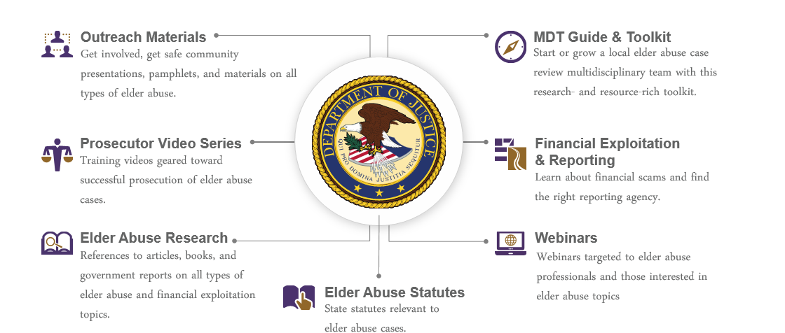
Elderjustice.gov
You're fighting elder abuse on the front lines. We've got your back.
The mission of the Elder Justice Initiative is to support and coordinate the Department’s enforcement and programmatic efforts to combat elder abuse, neglect, and financial fraud and scams that target our Nation’s seniors.
Notes:
The elder justice website maintains resources for prosecutors, law enforcement officers, victim service providers, as well as victims and their loved ones.

Slide 5

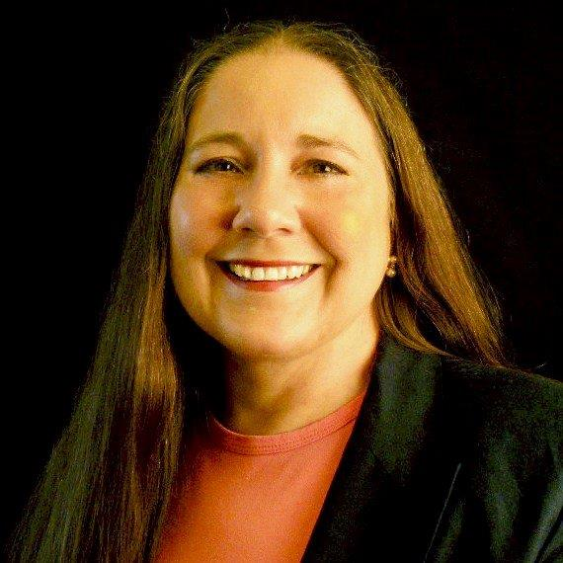
presenters
Keeley Frank Senior Services Specialist VictimConnect Resource Center, NCVC
Trudy Gregorie Executive Director, NAPSA

Slide 6
Successful Collaboration Between APS And Victim Services
Keeley Frank, Senior Services Specialist
VictimConnect Resource Center
National Center for Victims of Crime
Trudy Gregorie, Executive Director
National Adult Protective Services Association

Slide 7
About NCVC
The National Center for Victims of Crime (NCVC) was formed in 1985 as the Nation’s leading resource and advocacy organization for victims of all types of crimes and for the people who serve them.
Advocates for stronger rights, protections, and services for victims.
Provides critical training, education, and evaluation.
Serves as a trusted source of current information on victims’ rights.

Slide 8



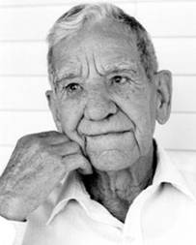
About NAPSA
Formed in 1989 as a national association for adult protective services (APS) professionals.
Strengthen APS via—
Education
Research
Advocacy

Slide 9
About APS
64% of APS are state-administered, 15% are county-administered, and 21% are administered various other ways, including NPOs on contract.
Serves as a victim-focused, social services response.
Receives abuse reports and attempts to remedy or reduce abuse.
Works with law enforcement, criminal justice, area agencies on aging, and other aging services.

Slide 10
APS ≠ APS: Variations Among States and Communities
No common definition of who is served in each state nor what services they receive.
Residence of victim – APS investigates in—
Community: 100% of states
Facilities: 50% of states
Eligibility for APS response—
42 states: all adults with disabilities age 18+
Some states: age 60+ only, or must be age 60+ and meet the state definition of “vulnerable”

Slide 11
Multidisciplinary Approach
Faced with ever-increasing caseloads, as well as increased case complexity, APS staff work hard to locate and access needed services for clients.
Multidisciplinary cooperation is at the heart of APS work, whether through formal multidisciplinary teams (MDT) or informally across community agencies and colleagues.
APS works closely with law enforcement agencies, prosecutors and courts, community-based aging services, and, more and more, with victim services.

Slide 12
Crime Interrelationship with Elder Abuse
Homicide
Assault & battery
Sexual assault
Domestic violence
Institutional abuse, neglect & fraud
Theft & fraud
Identity theft
Drugs

Slide 13
Basic Crime Victim Services
Needs assessment
Crisis intervention
Emergency financial assistance
Home safety checks
Safety planning
Social support enhancement
Medical issues
Mental health counseling
Victim support groups
Legal advocacy
Referrals for social services

Slide 14
Why Collaborate?

Slide 15



Working with Older Victims and Survivors

Slide 16
Assisting Older Victims
Multiple needs
Older persons’ abilities are along a continuum
Multiple victimizations
Polyvictimization – abusers or forms of abuse
May have long history of abuse
Fewer personal alternatives
Fewer community resources
The victim may be dependent on the abuser or the abuser may be dependent on them
May need help from multiple systems

Slide 17
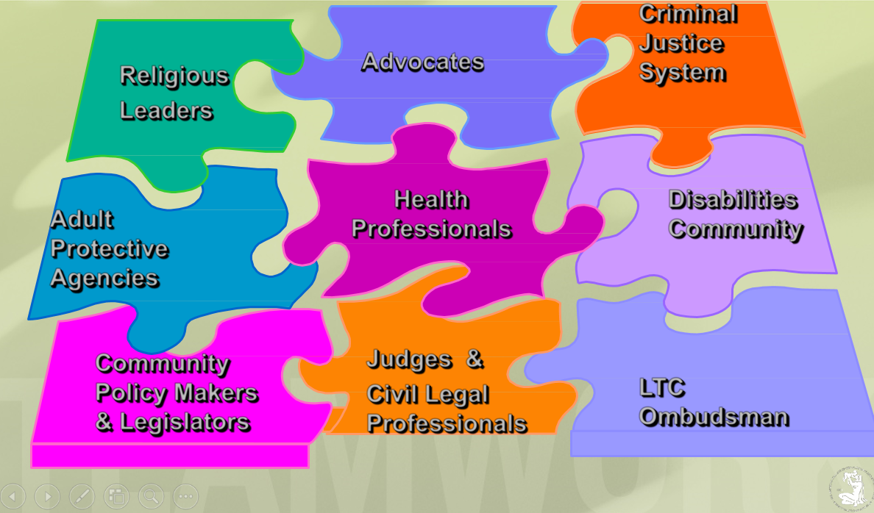
Coordinated Community Response

Slide 18
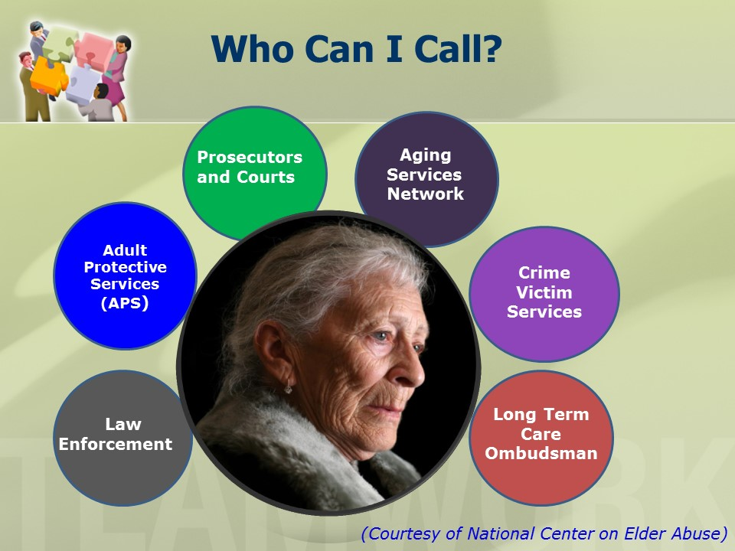

Slide 19










“No Wrong Doors” Approach
(From National Center on Elder Abuse)
Informal Networks and Existing Relationships
APS or Law Enforcement
Investigators
Community Services and Advocacy

Slide 20
Collaborating on Older Victims’ Rights and Services
Information & referral services
Implementation of victims’ rights
Training & technical assistance
Public policy initiatives
Research initiatives & data collection
Increase funding and awareness

Slide 21
Building Bridges
Be proactive in building a bridge with your local APS and your local victim service providers.
Find out where APS and victim services are housed in your community.
Find out what types of vulnerable adult abuse is reported to APS under your state’s laws, how your services overlap, and where there are gaps.
Find out where/how to locate aging services in your community.
Working together is critical to serving abused vulnerable adults effectively!!

Slide 22
How APS and Victim Services Can Better Interact
Get to know how each other’s systems work.
Create opportunities to cross-train.
Invite each other to serve on local MDTs, coalitions, or task forces.
Develop memoranda of understanding or interagency agreements for collaboration on older victim issues, individual case management, and elder justice.

Slide 23
Engaging Networks and Coalitions
Develop partnerships for—
Public awareness activities (can link to victim-related commemorative observances and to WEAAD or Older Americans Month)
Victim- and elder justice-related public policy development and implementation
Committees and task forces
Ongoing funding for mutual interests and issues

Slide 24
Why collaborate on strategic planning around elder abuse?
Current environment, everyone must focus on making operations as efficient and effective as possible, including APS and victim services.
Increasing demands for services, shrinking resources, and greater expectations.
Strategic planning is a proactive tool to seek and manage change.

Slide 25

National Resource
Anonymous
All crimes
200+ languages
National & local referrals

Slide 26

Q&A

Slide 27
Keeley Frank Senior Services Specialist VictimConnect Resource Center, NCVC kfrank@victimsofcrime.org Trudy Gregorie Executive Director, NAPSA trudy.gregorie@napsa-now.org
Questions & Suggestions
Elder Justice Initiative
E-mail: elder.justice@usdoj.gov
Website: www.elderjustice.gov

Slide 28
