Slide 1





Responding to Elder Abuse Victims with Alzheimer’s Disease or Other Dementias
July 19, 2018

Slide 2
Technical overview
      If you are experiencing any technical issues with the audio for this session, please let us know in the feedback box.
      If you have technical difficulties during the webinar, contact Kaila Hough, who is providing technical support for this webinar. Her email address is khough@ovcttac.org.
      If you have questions, type them in the feedback box. We will address as many as possible throughout the webinar.

Slide 3
Elder Justice Initiative
The mission is to support and coordinate the Department of Justice’s enforcement and programmatic efforts to combat elder abuse, neglect, and financial fraud and scams that target older adults.
The Initiative does so by—
      Promoting justice for older adults.
      Helping older victims and their families.
      Enhancing state and local efforts through training and resources.
      Supporting research to improve elder abuse policy and practice.
Notes:
Talitha

Slide 4
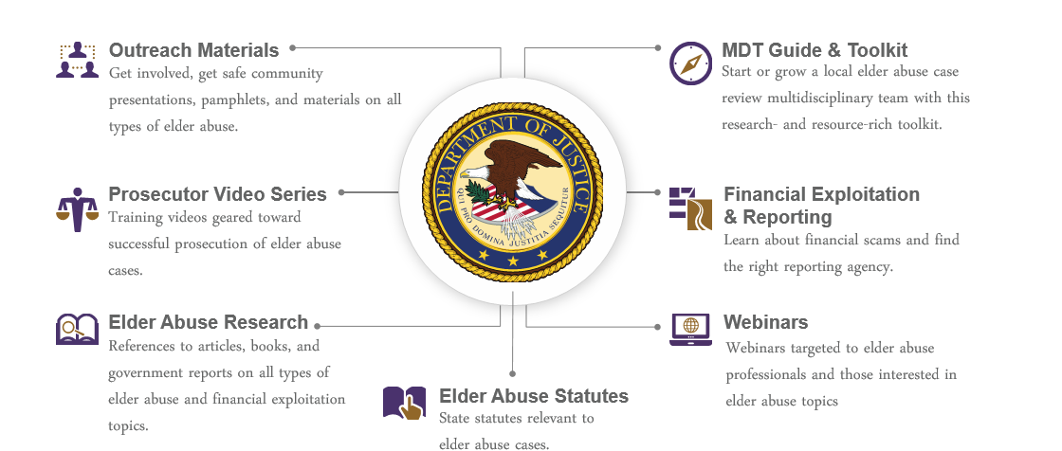
Elderjustice.gov
You're fighting elder abuse on the front lines. We've got your back.
The mission of the Elder Justice Initiative is to support and coordinate the Department’s enforcement and programmatic efforts to combat elder abuse, neglect, and financial fraud and scams that target our Nation’s seniors.
Notes:
The elder justice website maintains resources for prosecutors, law enforcement officers, victim service providers, as well as victims and their loved ones.

Slide 5
presenters
Lt. Hank Levenson (Ret.)
Sgt. Tim Sutton

Slide 6
Objectives Covered Today
Proper response to these calls
Dealing with and understanding Alzheimer's patients
Working with and understanding the caregiver
Protecting everyone while on these calls
Effective methods for search and rescue
Additional resources available

Slide 7

Alzheimer's in America
Module 1
Understanding Alzheimer's

Slide 8

Prevalence
5.4 million
in the US
24.3 Million Worldwide
*

Slide 9
The Year 2050
Life Expectancy Will Reach 90+
Over 70 million people will be over the age of 65; 10% will have
Alzheimer’s disease.
Close to 20 million will be over the age of 85;. 50% will have Alzheimer’s disease

Slide 10


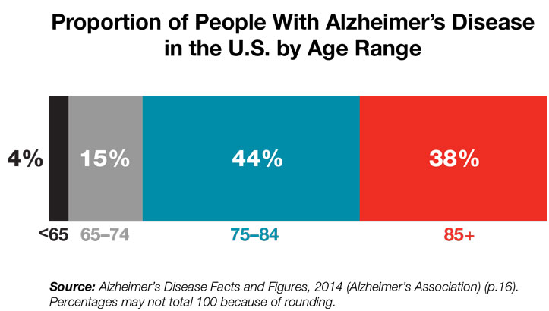
Why the dramatic increase?
Baby Boomers are getting older
Veterans with PTSD
Advanced medical testing
Better education
Being diagnosed in younger people

Slide 11





Who is Affected by Alzheimer's?
Son / DaughterGrandma / Grandpa
Brother / Sister
Mom / Dad
Friend

Slide 12

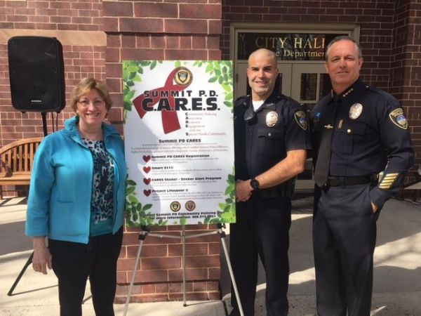
Alzheimer's Awareness
How does it impact Law Enforcement
  Missing/Lost patients
  Found patients
  Traffic stops/Driving Issues
  Wanderers
  Other calls for service
  Risk assessment

Slide 13

What is DEMENTIA?
A loss of intellectual functioning such as thinking, remembering, and / or reasoning…

Slide 14

Dementia
Alzheimer’s
Strokes
Cancer
Alcohol
Brain Injury
Parkinson’s
Numerous Others

Slide 15

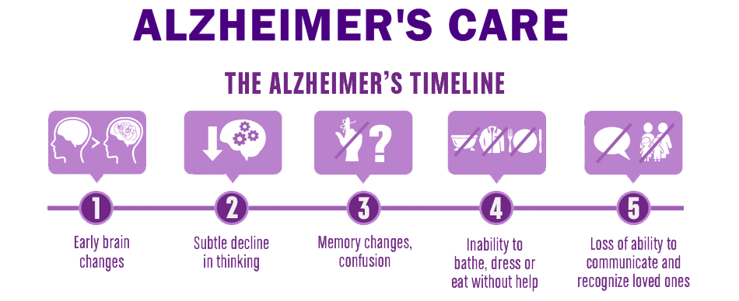
The Life and Loss of Lenny

Slide 16
LEO
Breath
Swallow
DIVORCE
Moves In
Retire
Married
Jane
2nd Marriage
Betty
Social
Skills
Driving
Multi-
Tasking
Rolling
Walking
Potty Training
Frank
Lisa
Joe
Lori
Boy
Girl
Boy
Girl
Notes:
Julie McNiff was employed by the Alzheimer’s Association then went to work with DCJS as an Alzheimer’s Instructor from 1999-2011.
Draw a timeline starting with birth, and all of the things you learn in the beginning of life all the way to old age. Then show how Alzheimer’s erases it starting with your short term memory
Ex.:
You are born (you learn to breath, swallow, roll over)
Kindergarten (social skills) Elementary School (reading, writing, math) High School ( Learning to drive and getting license)
College/Military,
Becoming a Police officer
Getting married (plug in a name and show them having a male child and a female child)
Divorce
Remarried (Pick a different name for the second wife)
Two more Kids ( male and female different names that the first two)
Retirement
ONSET OF ALZHEIMER’S
Show how erasing the short term memory starts to affect behavior. Erase gradually explaining what might be happening in their mind as their memory is erased

Slide 17
LEO
Breath
Swallow
DIVORCE
Retire
Married
Jane
2nd Marriage
Betty
Social
Skills
Driving
Multi-
Tasking
Rolling
Walking
Potty Training
Frank
Lisa
Joe
Lori
Boy
Girl
Boy
Girl
Notes:
Julie McNiff was employed by the Alzheimer’s Association then went to work with DCJS as an Alzheimer’s Instructor from 1999-2011.
Draw a timeline starting with birth, and all of the things you learn in the beginning of life all the way to old age. Then show how Alzheimer’s erases it starting with your short term memory
Ex.:
You are born (you learn to breath, swallow, roll over)
Kindergarten (social skills) Elementary School (reading, writing, math) High School ( Learning to drive and getting license)
College/Military,
Becoming a Police officer
Getting married (plug in a name and show them having a male child and a female child)
Divorce
Remarried (Pick a different name for the second wife)
Two more Kids ( male and female different names that the first two)
Retirement
ONSET OF ALZHEIMER’S
Show how erasing the short term memory starts to affect behavior. Erase gradually explaining what might be happening in their mind as their memory is erased

Slide 18
LEO
Breath
Swallow
DIVORCE
Married
Jane
2nd Marriage
Betty
Social
Skills
Driving
Multi-
Tasking
Rolling
Walking
Potty Training
Frank
Lisa
Joe
Lori
Boy
Girl
Boy
Girl
Notes:
Julie McNiff was employed by the Alzheimer’s Association then went to work with DCJS as an Alzheimer’s Instructor from 1999-2011.
Draw a timeline starting with birth, and all of the things you learn in the beginning of life all the way to old age. Then show how Alzheimer’s erases it starting with your short term memory
Ex.:
You are born (you learn to breath, swallow, roll over)
Kindergarten (social skills) Elementary School (reading, writing, math) High School ( Learning to drive and getting license)
College/Military,
Becoming a Police officer
Getting married (plug in a name and show them having a male child and a female child)
Divorce
Remarried (Pick a different name for the second wife)
Two more Kids ( male and female different names that the first two)
Retirement
ONSET OF ALZHEIMER’S
Show how erasing the short term memory starts to affect behavior. Erase gradually explaining what might be happening in their mind as their memory is erased

Slide 19
LEO
Breath
Swallow
DIVORCE
Married
Jane
Social
Skills
Driving
Multi-
Tasking
Rolling
Walking
Potty Training
Frank
Lisa
Joe
Lori
Boy
Girl
Boy
Girl
Notes:
Julie McNiff was employed by the Alzheimer’s Association then went to work with DCJS as an Alzheimer’s Instructor from 1999-2011.
Draw a timeline starting with birth, and all of the things you learn in the beginning of life all the way to old age. Then show how Alzheimer’s erases it starting with your short term memory
Ex.:
You are born (you learn to breath, swallow, roll over)
Kindergarten (social skills) Elementary School (reading, writing, math) High School ( Learning to drive and getting license)
College/Military,
Becoming a Police officer
Getting married (plug in a name and show them having a male child and a female child)
Divorce
Remarried (Pick a different name for the second wife)
Two more Kids ( male and female different names that the first two)
Retirement
ONSET OF ALZHEIMER’S
Show how erasing the short term memory starts to affect behavior. Erase gradually explaining what might be happening in their mind as their memory is erased

Slide 20
LEO
Breath
Swallow
DIVORCE
Married
Jane
Social
Skills
Driving
Multi-
Tasking
Rolling
Walking
Potty Training
Joe
Lori
Boy
Girl
Boy
Girl
Notes:
Julie McNiff was employed by the Alzheimer’s Association then went to work with DCJS as an Alzheimer’s Instructor from 1999-2011.
Draw a timeline starting with birth, and all of the things you learn in the beginning of life all the way to old age. Then show how Alzheimer’s erases it starting with your short term memory
Ex.:
You are born (you learn to breath, swallow, roll over)
Kindergarten (social skills) Elementary School (reading, writing, math) High School ( Learning to drive and getting license)
College/Military,
Becoming a Police officer
Getting married (plug in a name and show them having a male child and a female child)
Divorce
Remarried (Pick a different name for the second wife)
Two more Kids ( male and female different names that the first two)
Retirement
ONSET OF ALZHEIMER’S
Show how erasing the short term memory starts to affect behavior. Erase gradually explaining what might be happening in their mind as their memory is erased

Slide 21
LEO
Breath
Swallow
Married
Jane
Social
Skills
Driving
Multi-
Tasking
Rolling
Walking
Potty Training
Joe
Lori
Boy
Girl
Boy
Girl
Notes:
Julie McNiff was employed by the Alzheimer’s Association then went to work with DCJS as an Alzheimer’s Instructor from 1999-2011.
Draw a timeline starting with birth, and all of the things you learn in the beginning of life all the way to old age. Then show how Alzheimer’s erases it starting with your short term memory
Ex.:
You are born (you learn to breath, swallow, roll over)
Kindergarten (social skills) Elementary School (reading, writing, math) High School ( Learning to drive and getting license)
College/Military,
Becoming a Police officer
Getting married (plug in a name and show them having a male child and a female child)
Divorce
Remarried (Pick a different name for the second wife)
Two more Kids ( male and female different names that the first two)
Retirement
ONSET OF ALZHEIMER’S
Show how erasing the short term memory starts to affect behavior. Erase gradually explaining what might be happening in their mind as their memory is erased

Slide 22
Breath
Swallow
Social
Skills
Driving
Multi-
Tasking
Rolling
Walking
Potty Training
Notes:
Julie McNiff was employed by the Alzheimer’s Association then went to work with DCJS as an Alzheimer’s Instructor from 1999-2011.
Draw a timeline starting with birth, and all of the things you learn in the beginning of life all the way to old age. Then show how Alzheimer’s erases it starting with your short term memory
Ex.:
You are born (you learn to breath, swallow, roll over)
Kindergarten (social skills) Elementary School (reading, writing, math) High School ( Learning to drive and getting license)
College/Military,
Becoming a Police officer
Getting married (plug in a name and show them having a male child and a female child)
Divorce
Remarried (Pick a different name for the second wife)
Two more Kids ( male and female different names that the first two)
Retirement
ONSET OF ALZHEIMER’S
Show how erasing the short term memory starts to affect behavior. Erase gradually explaining what might be happening in their mind as their memory is erased

Slide 23
Breath
Swallow
Notes:
Julie McNiff was employed by the Alzheimer’s Association then went to work with DCJS as an Alzheimer’s Instructor from 1999-2011.
Draw a timeline starting with birth, and all of the things you learn in the beginning of life all the way to old age. Then show how Alzheimer’s erases it starting with your short term memory
Ex.:
You are born (you learn to breath, swallow, roll over)
Kindergarten (social skills) Elementary School (reading, writing, math) High School ( Learning to drive and getting license)
College/Military,
Becoming a Police officer
Getting married (plug in a name and show them having a male child and a female child)
Divorce
Remarried (Pick a different name for the second wife)
Two more Kids ( male and female different names that the first two)
Retirement
ONSET OF ALZHEIMER’S
Show how erasing the short term memory starts to affect behavior. Erase gradually explaining what might be happening in their mind as their memory is erased

Slide 24
Notes:
Julie McNiff was employed by the Alzheimer’s Association then went to work with DCJS as an Alzheimer’s Instructor from 1999-2011.
Draw a timeline starting with birth, and all of the things you learn in the beginning of life all the way to old age. Then show how Alzheimer’s erases it starting with your short term memory
Ex.:
You are born (you learn to breath, swallow, roll over)
Kindergarten (social skills) Elementary School (reading, writing, math) High School ( Learning to drive and getting license)
College/Military,
Becoming a Police officer
Getting married (plug in a name and show them having a male child and a female child)
Divorce
Remarried (Pick a different name for the second wife)
Two more Kids ( male and female different names that the first two)
Retirement
ONSET OF ALZHEIMER’S
Show how erasing the short term memory starts to affect behavior. Erase gradually explaining what might be happening in their mind as their memory is erased

Slide 25
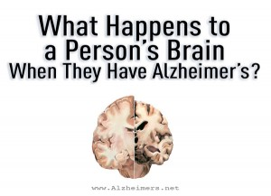
A Progressive Brain Disorder

Slide 26
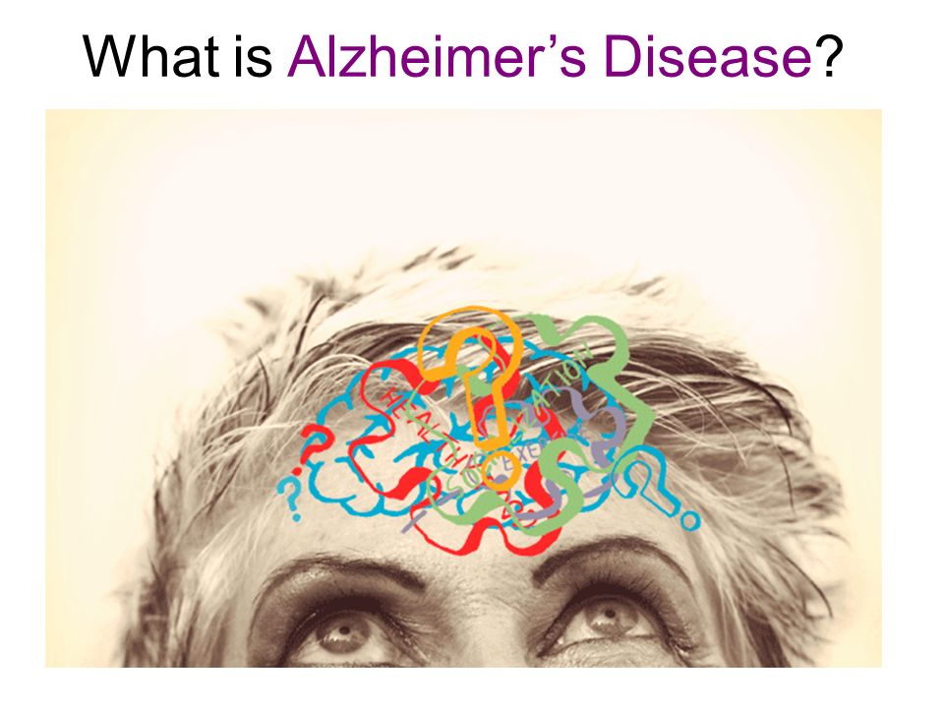

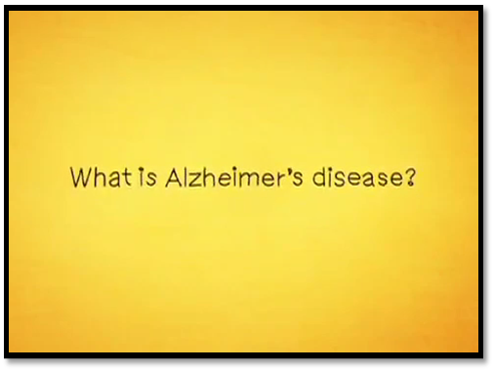
Alzheimer's Disease Video

Slide 27
Stigma of Alzheimer's Disease
Denial
It’s not Alzheimer's, it’s Dementia
It just a little memory loss, it happens to us all
It’s progressive memory loss
It’s a cognitive deterioration of the brain

Slide 28
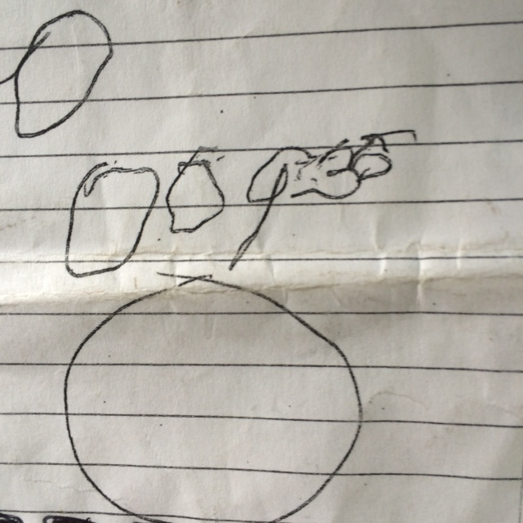
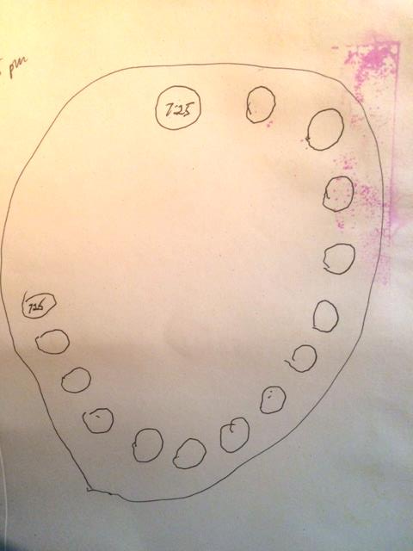
Clock Test

Slide 29
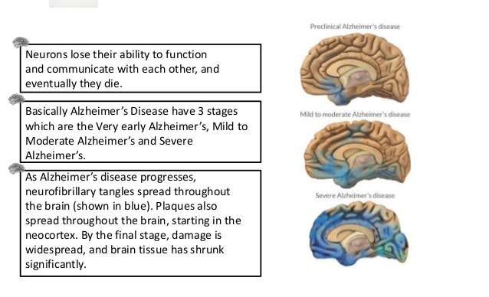
The Three Stages of Alzheimer's
Early Stage
Middle Stage
Late Stage

Slide 30
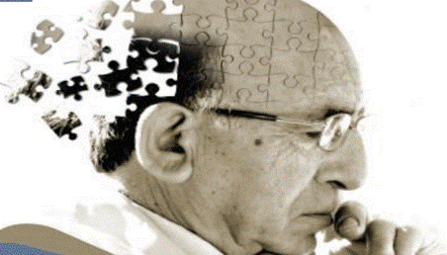
Symptoms of Early Stage
Forgetfulness
Speech issues
Poor judgment
Losing things
Taking longer to complete daily activities

Slide 31
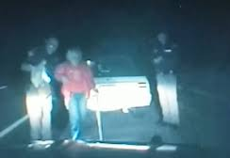

Early Stage- Possible LE Observations
Speech problems
Driving problems
Difficulty locating documents you request
(i.e. license, proof of insurance)
Shoplifting

Slide 32
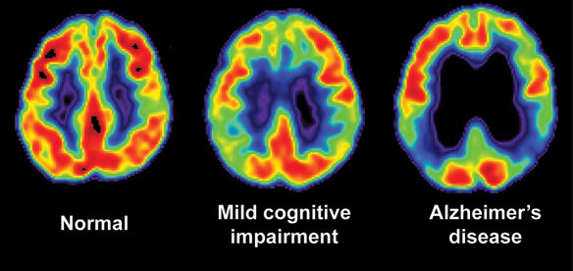
Symptoms of Middle Stage
Increased memory loss and confusion
Problems recognizing people
Inability to learn new things
Poor motor skills
Unbalanced walking

Slide 33
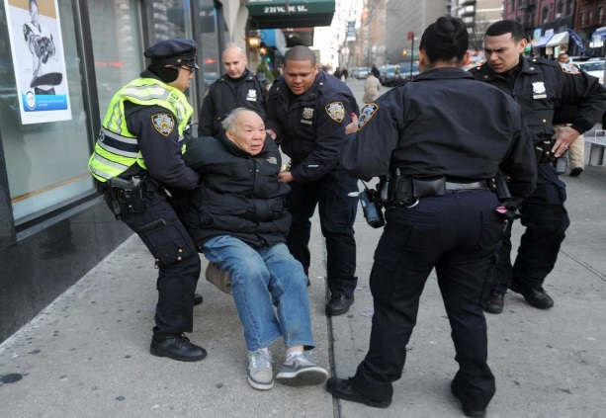
Middle Stage- Possible LE Observations
Speech problems
True disorientation
Issues with basic needs
Driving impairment
Wandering
Being uncooperative

Slide 34
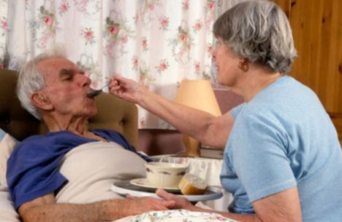
Late Stage Symptoms
Inability to recognize oneself or family
Inability to communicate
Weight loss
Skin infections
Difficulty swallowing
Groaning, moaning, or grunting
Increased sleeping
Lack of control of bowel and bladder

Slide 35
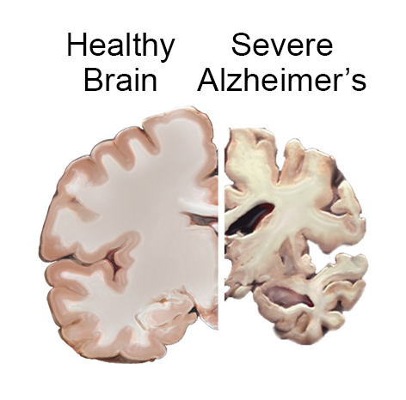
Late Stage- LE Observations
Signs of elder abuse and neglect
Calls for assistance
Wandering
Suicide
Homicide

Slide 36


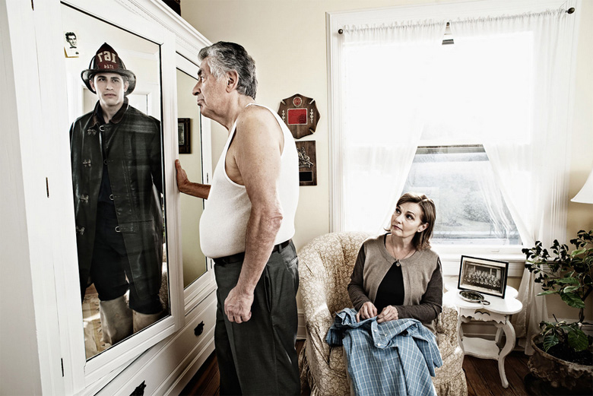
What Goes Thru The Mind Of
Someone With Alzheimer’s
(This Could Be You…)

Slide 37
Medications
Donepezil HCl
Memantine HCI
Galantamine HBr
Tacrine Hydrochloride

Slide 38

Wandering Off
Approximately 60% of patients will wander off at some point
Approximately 70% of those will wander repeatedly
May not remember name, address and may become disoriented even in familiar places
Term “wandering” is misleading, most become disoriented doing routine activities

Slide 39

Wandering Off Cont.
Often Have An Intended Mission (Real Or Imagined)
  Searching For Something
  Escaping From Something
  Reliving The Past
  May Not Recognize Signals To Stop (Pain, Thirst, Hunger, Dehydration)

Slide 40
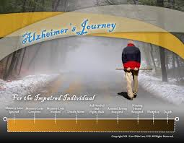
Wandering Off Cont.
Unlikely to shout for help (don’t know they are missing)
Seldom take a logical path
May walk straight until they hit a barrier
Will often hide or seclude themselves
Don’t know the dangers of water

Slide 41
Wandering Off Cont.
Most will wander on foot
Normally during the daytime
Have an intended mission
Sundowning
50% Will Become Seriously Injured Or Die Within The First 24 Hours If Not Found

Slide 42
Wandering Off Cont.
According to a Virginia study: (on foot)
  94% of all cases are within 1.5 mile of the “point last seen”
        Nearly 70% are found within residence
  If not in residence, usually found A short distance from A road
  If not found on A road, 63% were found in A creek, drainage ditch, and/or caught in briars or bushes
  80% of those found after 72 hours died of hypothermia, drowning, or dehydration

Slide 43
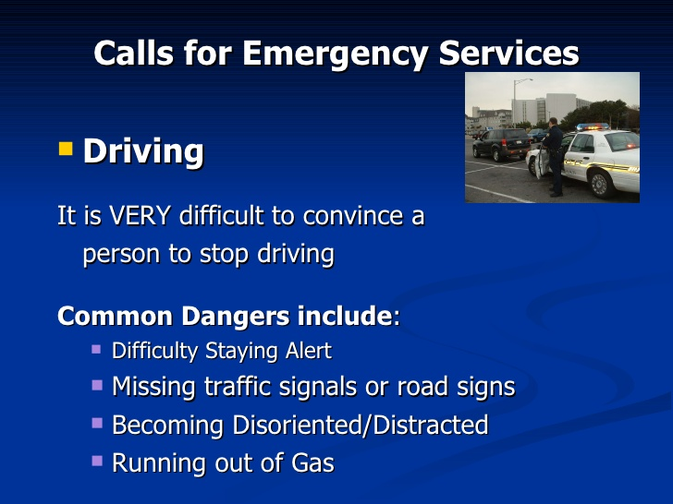

Driving Issues We May Face

Slide 44

Dealing With The
“Insistent Unsafe Driver”
Discuss with caregivers
Review common dangers
Suggest DMV medical review form
Recommend getting a ‘no driving prescription’
No driving contract
Suggest disabling or selling the vehicle

Slide 45
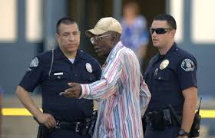
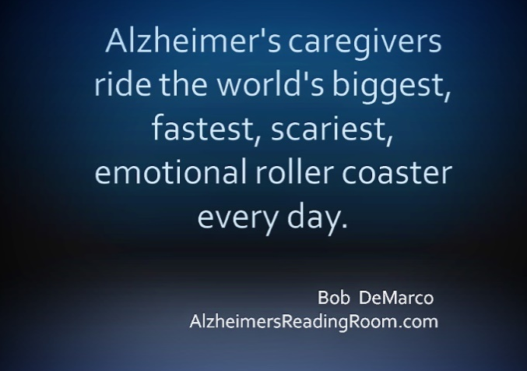
Interviewing Caregivers
Ask Family Members
  Have They Gone Missing Before/Wandered Off
  Time
  Where May They Go
  Time Period May They Be In
  Check The House Yourself
  Treat Like A Crime Scene If Needed
  Get A Picture Of Patient

Slide 46

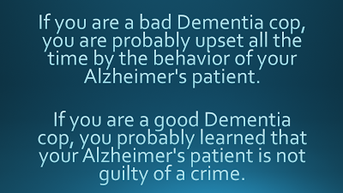

What LE May Encounter
Domestic Violence
Suicide and Homicide
Calls about abuse
Shoplifters
Neglect
Emergencies
Wandering or Lost
Theft or Home Invasion

Slide 47
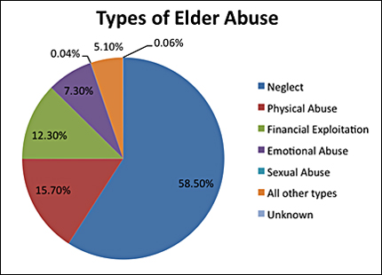
Exploitation
Easy Targets (can’t remember)
Phone Scams
“Friends”
Nursing Home/Assisted Living
CNA’s/Nurses
Check Pawn Lists
Unfortunately Public Safety
http://topmedicalassistantprograms.org/elder-abuse-prevention-guide/

Slide 48

Exploitation
Medications
Jewelry
Money
Abuse and Neglect
(Are you mandatory reporters for APS?)
Having them sign documents

Slide 49

Communicating Effectively
What should we do when dealing with an Alzheimer's Patient
What NEVER to do when dealing with an Alzheimer's Patient
Risk Management
Consider what they may be feeling and / or thinking
They are not criminals; they are someone's loved ones

Slide 50
Interaction with Alzheimer's Patients
People with dementia are easily startled, approach from the front
Always maintain eye contact
Keep your voice soft, and pleasant
Smile!
Speak slowly and calmly
Be prepared to identify yourself
Short, simple sentences
One question at a time. Don’t overwhelm them
Try to eliminate background noise, if possible
If you’re asking a question, wait patiently for the answer
If he or she can’t find the word…help them out by finishing the thought
Be prepared to repeat. Repeat. And repeat.

Slide 51
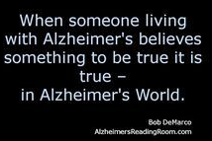
What Not To Do When With An Alzheimer's Patient
Don’t argue. Ever.
If you’re getting angry or frustrated…STOP! Try again later.
Don’t be sarcastic. And don’t – ever – talk down to them.
Don’t correct them. As far as you’re concerned…they’re right.
Never demand. Request.
Speak slowly. Hurrying will only increase their frustration…and yours.
Always remember: It’s not personal.

Slide 52

Officer Safety Comes First
Never Let Your Guard Down
Always Be Prepared
Always Adhere to Officer Safety Standards
Use Caution
But remember who you may be dealing with!

Slide 53

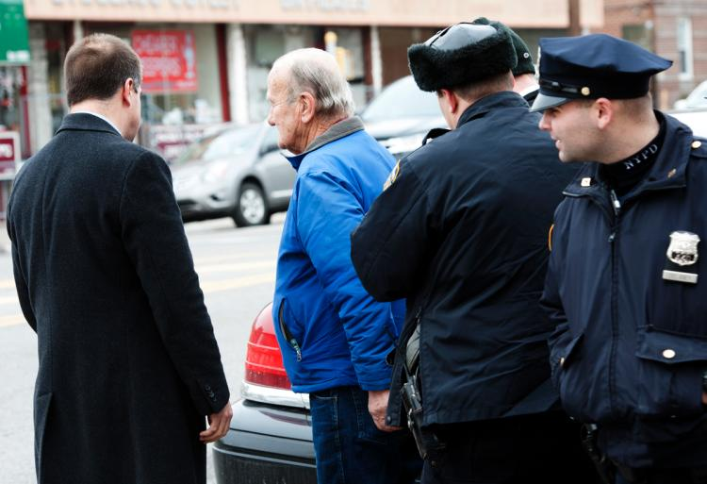
Using Your Unit For Safety- Lets Think About It
Caged units
Confinement
Radios blaring
Weapons
Flashing lights
To cuff or not to cuff
Other concerns

Slide 54
Community Collaboration
Social Services
Caregiver Support
Family Advocacy
Service Organizations
State and Local Agencies
Resources for Alzheimer's Patient and Care Givers
Council on Aging
Critical Care Clinics
Hospitals
Department Of Motor Vehicles

Slide 55
Policies
Every Agency Should have a Specific Policy on Responding to Alzheimer's Patients
  Response
  Search and Rescue
  Care Givers

Slide 56
Other Steps & Resources to Consider
Roll Call Trainings
Crime Prevention Units
Educate Citizens
Invite Alzheimer's Association to meetings
Encourage Family Members to keep in touch
Mutual Aid for Investigations and Searches
Others ?
Take Me Home Program

Slide 57





Thank you!
Please Recommend and Review Us
Hank Levenson – Next Generation Training www.nextgentraining.org
Tim Sutton- A Better Understanding www.a-betterunderstanding.com
Hank@NextGenTraining.org
info@a-betterunderstanding.com
Hank Levenson- 504-232-7676
Tim Sutton – 804-572-3132

Slide 58

Q&A

Slide 59
Questions
Elder Justice Initiative
Elder.justice@usdoj.gov
www.elderjustice.gov

