Slide 1
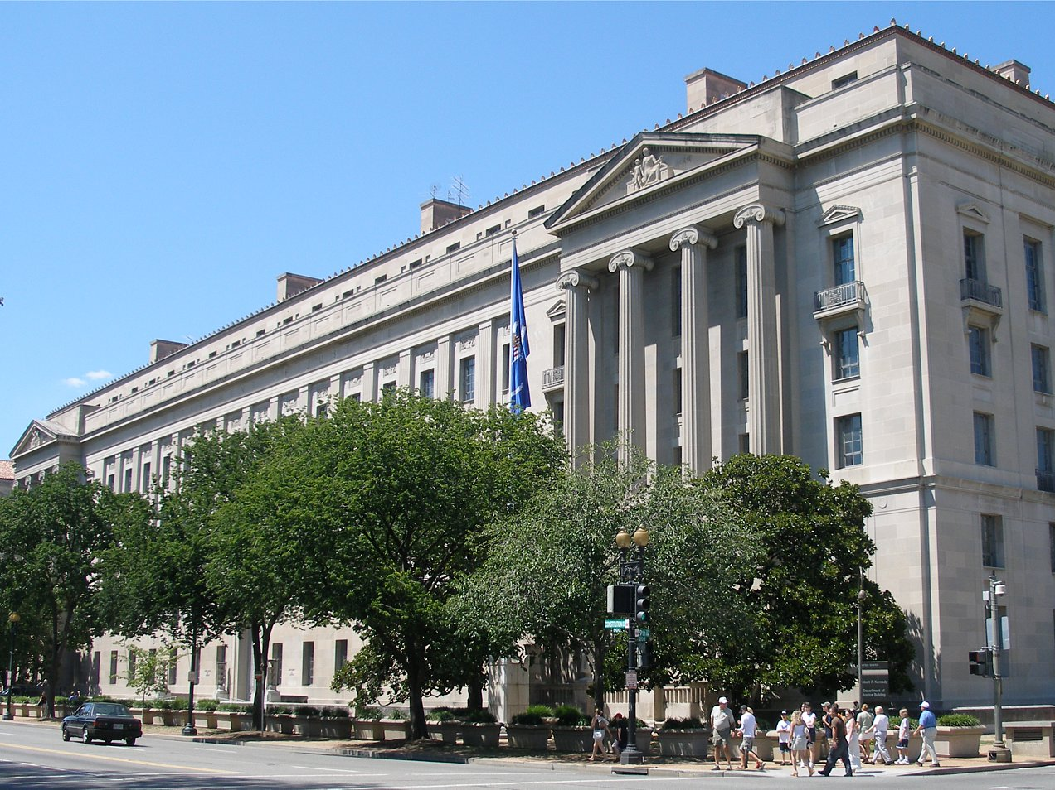




What Judges Should Know About Elder Abuse
August 10, 2018

Slide 2
Technical overview
      If you are experiencing any technical issues with the audio for this session, please let us know in the feedback box.
      If you have technical difficulties during the webinar, contact Jason Adams, who is providing technical support for this webinar. His email address is jadams@ovcttac.org.
      Today’s session will be recorded and made available on the training website.
      If you have questions, type them in the feedback box. We will address as many as possible throughout the webinar.

Slide 3
Elder Justice Initiative
The mission is to support and coordinate the Department of Justice’s enforcement and programmatic efforts to combat elder abuse, neglect, and financial fraud and scams that target older adults.
The Initiative does so by—
      Promoting justice for older adults.
      Helping older victims and their families.
      Enhancing state and local efforts through training and resources.
      Supporting research to improve elder abuse policy and practice.
Notes:
Talitha

Slide 4
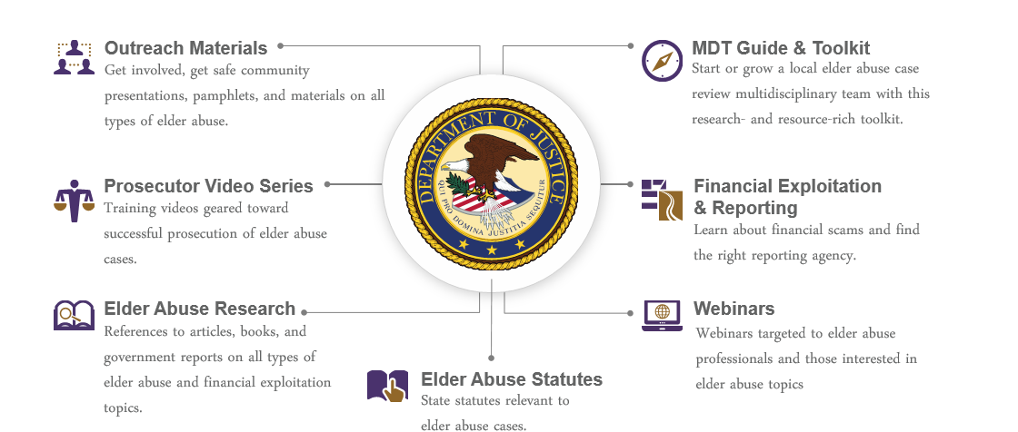
Elderjustice.gov
You're fighting elder abuse on the front lines. We've got your back.
The mission of the Elder Justice Initiative is to support and coordinate the Department’s enforcement and programmatic efforts to combat elder abuse, neglect, and financial fraud and scams that target our Nation’s seniors.
Notes:
The elder justice website maintains resources for prosecutors, law enforcement officers, victim service providers, as well as victims and their loved ones.

Slide 5
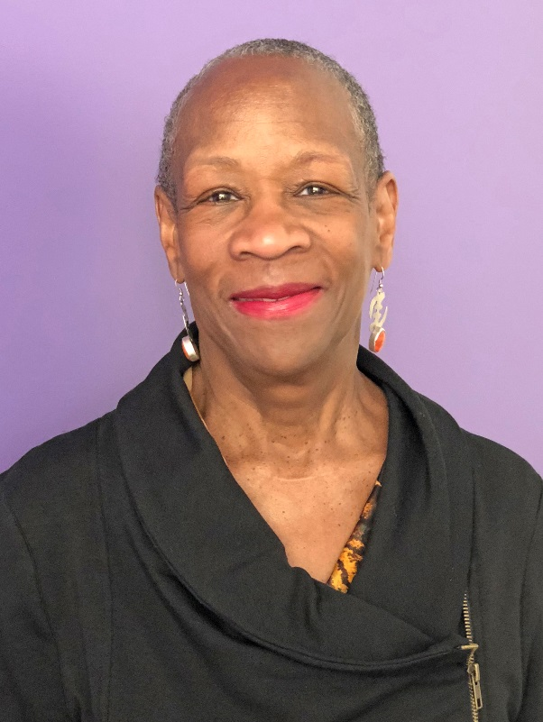
presenter
Hon. Karen Howze (Ret.)
Judge-in-Residence
National Council of Juvenile and Family Court Judges

Slide 6
What Judges Should Know About Elder Abuse
August 10, 2018
Hon. Karen Howze (ret.) Judge-in-residence
National council of juvenile and family court judges

Slide 7
Learning Objectives
As a result of this webinar, you will be better able to:
Identify the signs of elder abuse.
Understand the dynamics of elder abuse to fashion appropriate relief to meet the safety needs of individual victims.
Discuss, promote, and lead efforts to address abuse later in life in your courts and community.

Slide 8
The Numbers and a Few Facts
Population of older Americans is expanding—one in five Americans will be a senior citizen by 2030.
In the past century, life expectancy has increased by almost 30 years.
Just as domestic violence is underreported in the general population, abuse of elders is also underreported for many reasons.
Seniors are almost as likely to be stalked as younger people (Jasinski & Dietz, 2003).
Seniors’ voices are often left out of the national conversation.

Slide 9
The Numbers and a Few Facts
Older women are more likely to be assaulted in their homes than younger women. (Ekert & Sugar 2008).
Older women are more likely to be sexually assaulted by family and caregivers than by strangers.
Senior incest victims are often dependent upon the abuser for care, and many abusers depend on the elder for housing.
Older women victims of sexual assault are more likely to sustain physical injury in addition to psychosocial injury.
Elder victims of sexual assault are commonly disbelieved due to misconceptions about age/capacity and due to ageist assumptions.

Slide 10
Signs of Alzheimer's and Dementia | Typical Age-Related Changes
Poor judgement/decisionmaking | Making a bad decision once in a while
Inability to manage a budget | Missing a monthly payment
Losing track of the date or the season | Forgetting what day it is and remembering it later
Difficulty having a conversation | Sometimes forgetting which word to use
Misplacing things and being unable to retrace steps to find them | Losing things from time to time
Signs of Alzheimer’s and Dementia

Slide 11
Why does elder abuse occur and persist?

Slide 12
How Are Older People Harmed?
Accidents.
Well-intended caregivers.
Contact with persons with physical or mental health conditions that manifest in aggressive behavior.
Elder abuse: physical, emotional, sexual, neglect, etc.

Slide 13
Individual Actions
Greed
Power & Control
Motive

Slide 14
Common Abuser Justifications and Excuses
Section 2

Slide 15
Caregiver Stress
Providing care can be stressful.
Sometimes the stress is overwhelming and can lead to problems.
Caregivers often experience overeating, lack of sleep, depression, etc.

Slide 16
Abuse vs. Caregiver Stress
Caregiver Stress is Not a Cause of
Elder Abuse.
  Abusers use caregiver stress as an excuse to justify their behavior so they will not be held accountable and to create sympathy for themselves.
Notes:
Consider:
Early research was based on abuser’s self-reports.

Slide 17
Abuse vs. Caregiver Stress (2)
Everyone experiences stress—most do not abuse, neglect, or exploit a parent or partner.
The target is the older adult, not just anyone.
Generally, there is a pattern—not an isolated incident.
We would not tolerate similar circumstances with children or pets.

Slide 18
Abusers Create Smoke and Mirrors
Abusers often—
Lie
Manipulate
Charm
Justify their behavior
Blame the victim and others
Notes:
Offender Excuses:
“I have a problem with my temper”
“I was drunk or high”
“I have Alzheimer’s disease. It’s not my fault.”
“He hit me when I was a child”
“In my culture, elders share their resources”

Slide 19
Abusers Exploit Vulnerabilities
Economic Dependency
Religious Pressure
Family Pressure
Lack of Alternatives
Hope
Love
Fear
Distrust of the System
Complications of Immigration

Slide 20
What Are Judges Looking For?
Section 3

Slide 21
Undue Influence
A pattern of manipulative behaviors that enable an exploiter to get a victim to do what an exploiter wants, even when the victim’s behaviors are contrary to his or her previous beliefs, wishes, and actions.

Slide 22
Evidence of Undue Influence
Financial Records
Tax Records
Loan Applications
Civil Litigations
Toxicology
Medical Records
Mental Health Records
Notes:
How Might Undue Influence Manifest in Court?
Deny
Recant
Confusion
Anger
Depression
Inconsistency
Inability to make decision
Fear
Disbelief
Distrust system
Acquiescence with tactics
Powerlessness
Evidence

Slide 23
Evidence of Capacity
Capacity: Continuum of decisionmaking abilities
Capacity is situational: What is happening now?
Capacity is contextual: What is the context of this person’s life?
Varies by complexity of the task to be done or decision to be made.
  The more significant the decision and the consequences of the decision, the higher the level of capacity required.
Notes:
Capacity is task-specific, not global.
Enter into contract
Make a gift
Manage finances
Engage in complex planning and execution of steps
Personal care

Slide 24
Capacity (2)
Mental capacity includes the ability to—
Think clearly
Recall accurately
Organize thoughts
Express thoughts through communication
Plan and execute actions

Slide 25
Capacity (3)
Capacity can fluctuate.
  Medical condition, illness
  Medication
  Time of day
  Events in a person’s life, e.g., grief, loneliness
Experience and education may be related to the ability to understand complex financial transactions.
  Literacy and the extent of education may be related to the ability to understand complex financial transactions.
  Language capacity may be relevant to the ability to understand these transactions.

Slide 26
Deciding Capacity
Requires an expert’s assessment
Focuses on a person’s abilities
Presumption of capacity
Courts must—
  Fact find with competent evidence
  Determine capacity
  Incapacity: Tailor a guardianship that is based on the individual’s capacity, is appropriate, safe, and respects the elder’s wishes.

Slide 27
Deciding Capacity (2)
If the person has capacity—
  Court may suggest other community resources to assist the elder.
  Presence of undue influence? Court may seek information about the degree to which the subject is making decisions that are contrary to long-held patterns of behavior or beliefs.

Slide 28
Self-Neglect
Self-neglect occurs when a person fails to meet his or her own physical, psychological, and/or social needs.

Slide 29
Self-Neglect (2)
Signs include—
  Dehydration
  Malnutrition
  Hypothermia/hyperthermia
  Excessive dirt or odor
  Hazardous, unsafe, or unclean living conditions
  Inadequate or inappropriate clothing
Absence of needed eyeglasses, hearing aids, dentures, or prostheses
Unexpected or unexplained deterioration of health
Bedsores
Signs of excessive drugging
Refusal to take medication or other drug misuse

Slide 30
Abuse or Self-Neglect?
The danger for courts is to mistake these symptoms as self-neglect when they can be indicative of abuse. The distinction will impact the appropriateness of interventions.
Intervention in cases of self-neglect must always recognize the rights of elders.
When legal considerations have been respected, family, community and social services, and health care interventions can, in many cases, help make the situation better.
Notes:
But, these can also be signs of elder abuse perpetrated by others!

Slide 31
Guardianships
If the judge determines that a subject lacks capacity, you must then consider all of the options to best preserve the elder’s dignity, keep the person safe, and protect his or her interests, whether financial or physical.

Slide 32

Medical cause?
Temporary or emergency?
Reports?
My observations?
Other info?
Procedural requirements met?
What is bringing this case to court now?
Is guardianship necessary and helpful?

Slide 33
Remember the Capacity Concepts
Capacity is situational
Capacity is contextual
Varies by complexity of the task or decision

Slide 34
Balancing Protection with Autonomy in Guardianship Cases
The goals in these cases are—
Balance well-being with rights.
Promote self-determination.
Provide guidance to guardians.
Make determinations of restoration.
Prevent undue influence.

Slide 35
Victim Safety and Autonomy in Protection Order Cases
No easy answers!
When considering whether to drop a protection order:
  Consider modifying the order to better meet the petitioner’s specific needs.
  Provide an explanation if issuing the order against the petitioner’s wishes.
  Consider each request individually; avoid the per se rule.
Ensure that petitioners have multiple opportunities to obtain advocacy, from filing of the petition through the entire course of proceedings.
Success = safety. And success is what each victim defines it to be.

Slide 36
What Judges and Court Personnel Should Know
Section 4

Slide 37
Institutional Accountability: What Can Courts Do?
Adapt court culture to meet the needs of the individual to ensure access to justice.
Consider—
Is it safe for the victim to be in the courtroom?
Is the signage adequate throughout the court?
Are forms in large fonts?
Are the interpreters being used appropriate for the case?
Are there any special accommodations needed (oxygen, hearing assistance, where is it best for the elder to sit to maximize access, etc.)?
Notes:
All court services must be accessible!
ADA provides flexibility for courts to choose reasonable method of accommodation
Consider long-term costs and practicality
Expect the unexpected! Different elders will require different accommodations.

Slide 38
Accommodations
Consider relocating services and hearings to someplace accessible, even the victim’s home.
Change the time of hearings.
Provide aides or personal assistants or allow already assigned aides to remain with the elder throughout the hearing.
Reposition parties in the courtroom when necessary, even the judge!
Notes:
Sound amplification
Sign language interpreters
Lip-reading interpreters

Slide 39
Coordinated Community Response to Elder Abuse
Elder abuse cases are complex and demand that professionals and community members identify solutions, services, and responses that are least restrictive, and promote victim safety and autonomy.
Multidisciplinary collaborations can prove most effective because of the increased array of resources, coordination of effort, and shared knowledge of all who are responding to the needs of older adults.
Judges should consider promoting—and even leading —the creation of such teams in their communities.

Slide 40
Coordinated Community Response to Elder Abuse (2)
Adult Protective Services
Advocacy (program- and system-based)
Aging services
Financial institutions
Housing
Community organizations
Health care (including public health)
Courts
Law enforcement (prosecutors, police)
Defense bar (criminal and civil)
Anyone else?
Notes:
What are some of the systems (e.g., programs, government agencies, organizations, businesses) that have a role in responding to elder abuse victims?

Slide 41
What will you do to improve life for victims of elder abuse in your court and community?

Slide 42

Q&A

Slide 43
Thanks for Joining the Webinar `
The Hon. Karen Aileen Howze
Judge-in-Residence
National Council of Juvenile and Family Court Judges
  Reno, NV
  WWW.NCJFCJ.ORG
khowze@ncjfcj.org

Slide 44

The NJDIV is a partnership of Futures Without Violence, the National Council of Juvenile and Family Court Judges, and the Office on Violence Against Women, U.S. Department of Justice.

Slide 45
Questions
Elder Justice Initiative
Elder.justice@usdoj.gov
www.elderjustice.gov

