Slide 1

The DEVASTATING impact
OF FENTANYL AND CARFENTANIL
U.S. Attorney’s Office - SOUTHERN District of California
October 6, 2017
Acting U.S. Attorney Alana Robinson
Southern District of California
Notes:
Good Morning Everyone
Thank yo

Slide 2
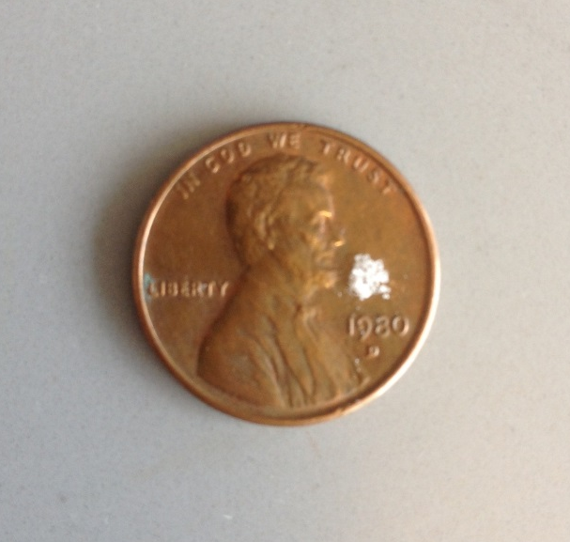
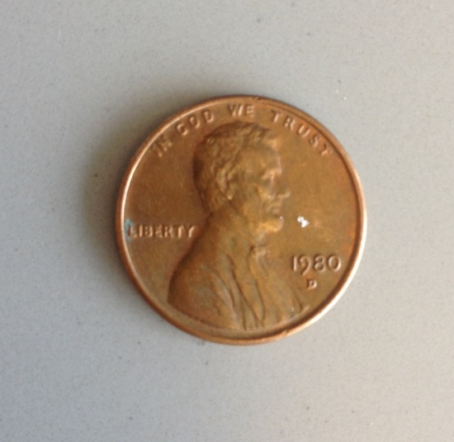
Fatal dose of fentanyl
(2 mg or 2000 mcg)
Fatal dose of carfentanil
(0.02 mg or 20 mcg)

Slide 3
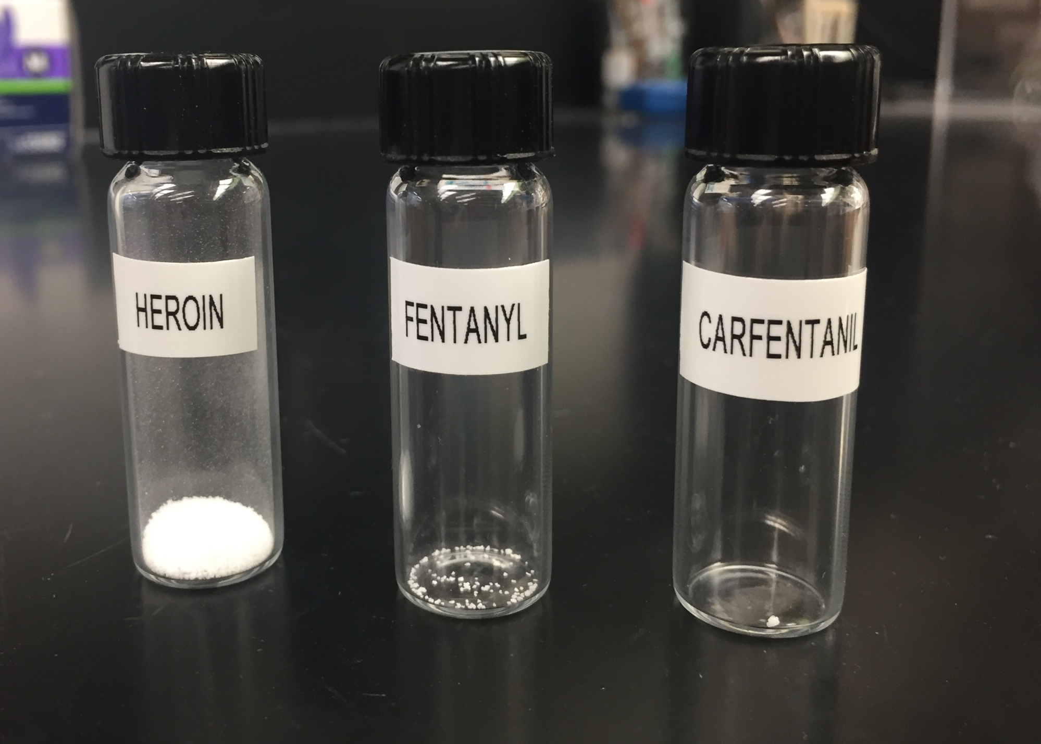
RELATIVE STRENGTH

Slide 4
Data by Ray Gary, Forensic Toxicologist, SD County Department of the Medical Examiner (2017 through September*)
*Note: 11 more fentanyl-related cases currently pending confirmation.

Slide 5
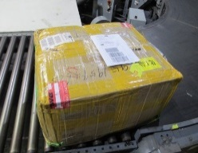
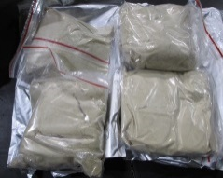
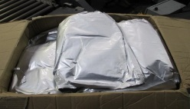
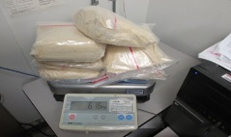
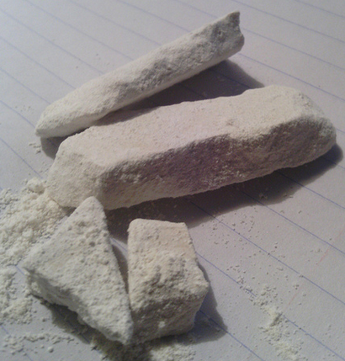
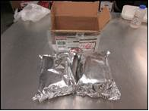
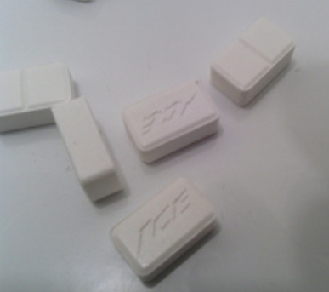
FY2017
54 Fentanyl Seizures
480.45 Kilograms
FY2016
19 Fentanyl Seizures
223 Kilograms
FY2015
6 Fentanyl Seizures
30 Kilograms

Slide 6
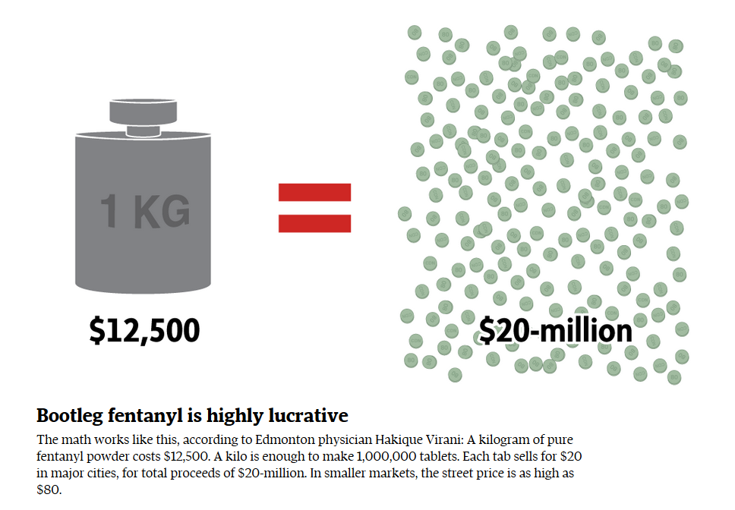
$32,000
Notes:
A kilogram of pure fentanyl, purchased from China for less than $5,000, is so potent that it can be stretched into 16 to 24 kilograms when using cutting agents like talcum powder or caffeine. Each kilogram can then be sold wholesale for up to $80,000 — for a total profit in the neighborhood of $1.6 million. Putting fentanyl in tablet for increases the profit substantially.

Slide 7
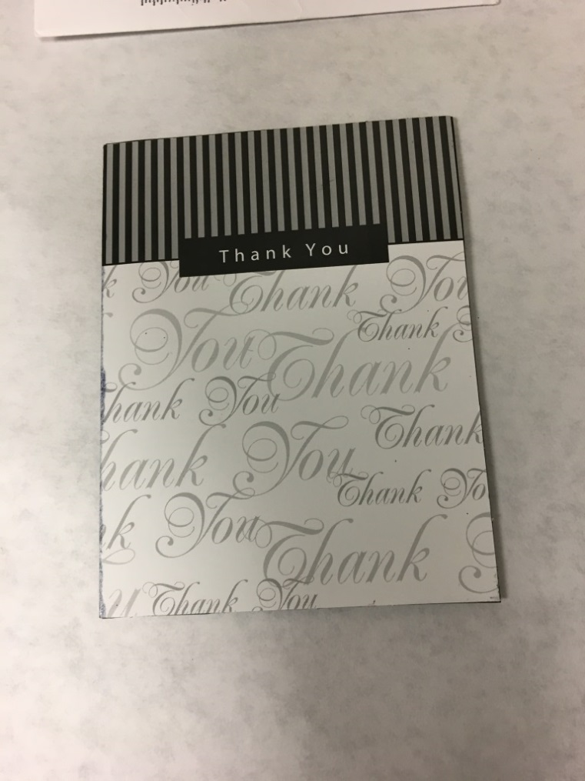
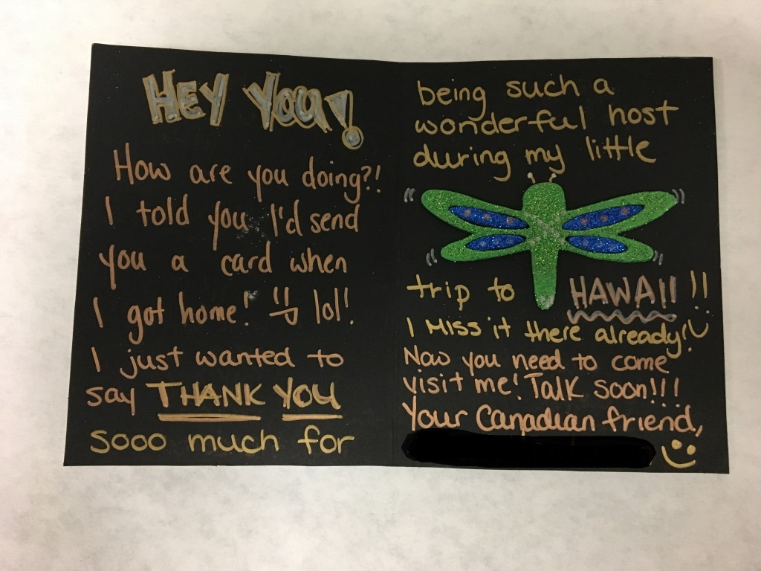
Dark Web Fentanyl Shipment

Slide 8
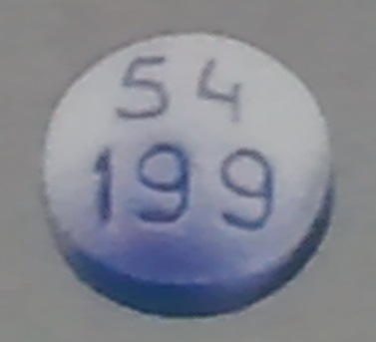
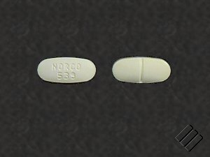
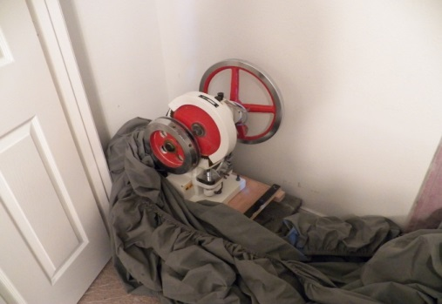
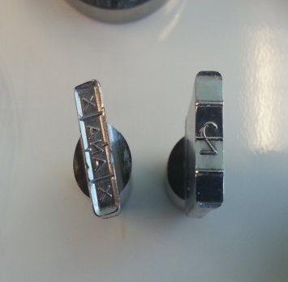
Counterfeit Tablets with Fentanyl
Pharmaceuticals – Clandestine
  Counterfeits
    Xanax
    Roxicodone
    Hydrocodone
  Tableting Machines
    Ordered from China
    Punch/Dies
      Trademarked Punch Dies are Contraband
      Users may not know what they are ingesting

Slide 9
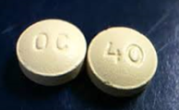
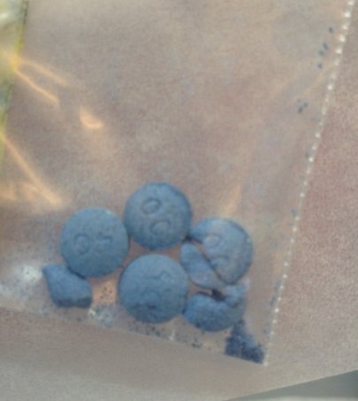
Pill with 20 Ingredients
Fentanyl
Fluoroisobutyrylfentanyl
Butyrylfentanyl
Methamphetamine
Chloroethcathinone
Alpha-PPP
Deschloroketamine
Cocaine
Levamisole
Caffeine
Lidocaine
Carbamazepine
TH-PVP
U-47700
4-ANPP
Diclazepam
Flubromazepam
Etizolam
Deschloroetizolam
Dibutylone
Overdose on April 2017
34 year old Male
Imperial Beach
Oxy Contin 40
should look
like this

Slide 10
San Diego County Crisis Hotline
888-724-7240
People who need help with mental health including alcohol or drug abuse, suicide prevention, medication needs, and more can call the San Diego County Crisis line at 888-724-7240. It’s open seven days a week, 24 hours a day.

Slide 11






Fentanyl Working Group Southern District of California
Notes:
Introduction of yourself

