Slide 1
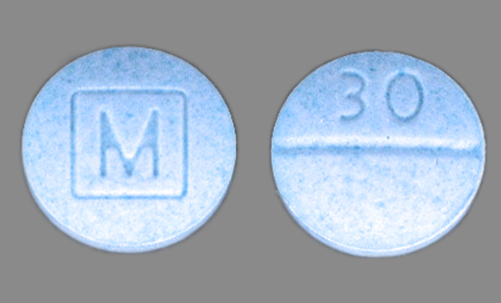
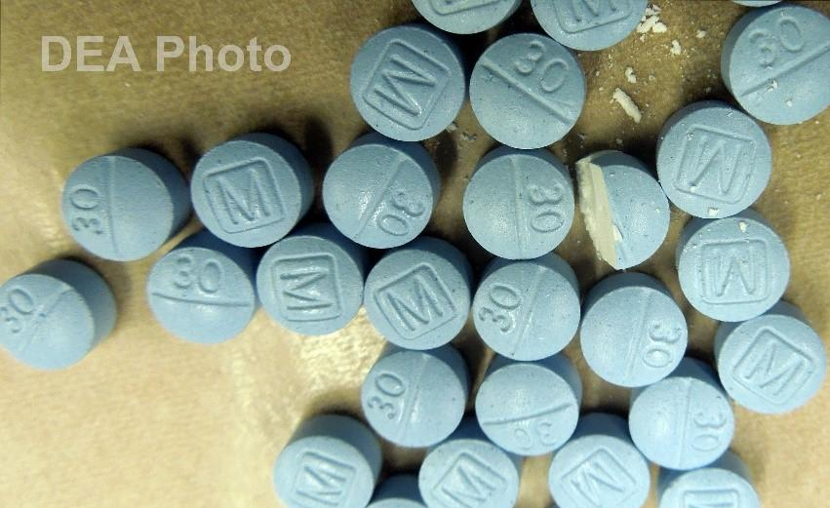
Legitimate Oxycodone 30mg
Counterfeit Oxycodone 30mg

